Slide 1
INFLUENCE OF PHOTOSELECTIVE NETTING ON GROWTH OF CHERRY LAUREL (Prunus laurocerasus L.) SAPLINGS
Damir Drvodelić*, Marko Vuković**, Tomislav Jemrić**
* University of Zagreb, Faculty of Forestry and Wood Technology, Institute of Ecology and Silviculture, Svetošimunska cesta 23, 10000 Zagreb, Hrvatska
**University of Zagreb Faculty of Agriculture, Division of horticulture and landscape architecture, Department of Pomology, Svetošimunska cesta 25, 10000 Zagreb, Croatia
Corresponding author: *Damir Drvodelić, ddrvodelic@inet.hr
NATURAL RESOURCES, GREEN TECHNOLOGY
& SUSTAINABLE DEVELOPMENT/4
14th and 16th September 2022
Hotel International, Zagreb, Croatia

Slide 2
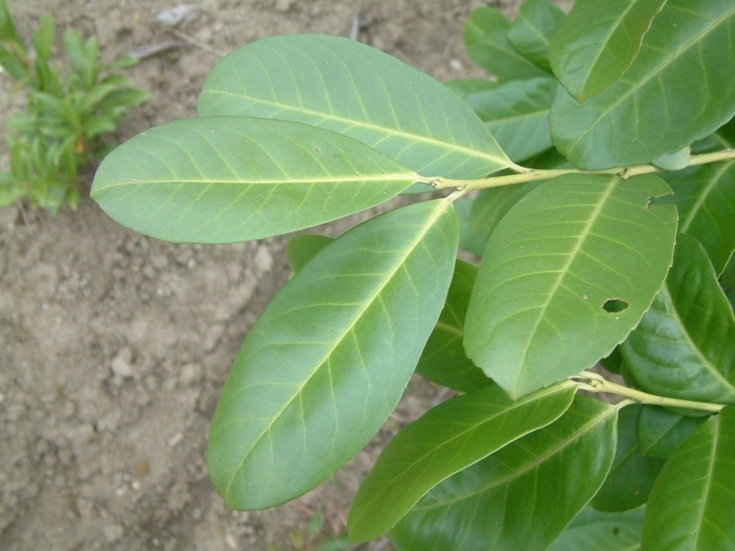
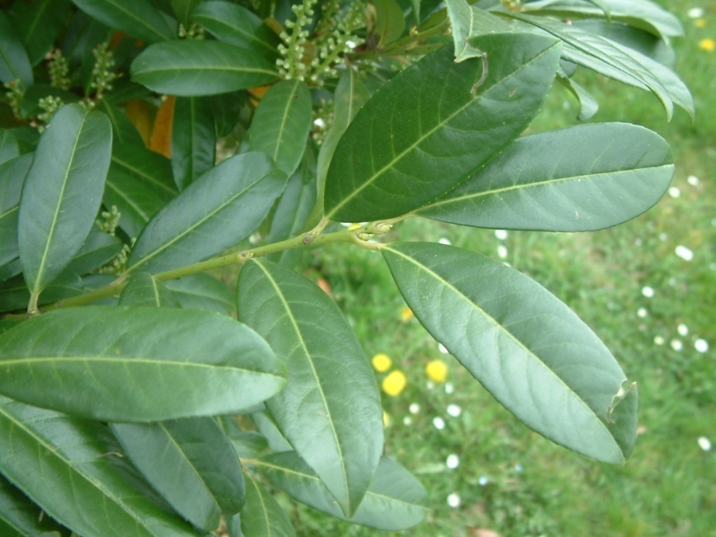
INTRODUCTION
• Laurel cherry (Prunus laurocerasus L.) is the bushy species most commonly used in horticulture for planting hedges.
• Because of its easy cultivation and decorative leaves, it is often used in horticulture. It is a fast-growing, heliophilic species that tolerates well shady locations, drought, pruning and air pollution, which makes this species ideal for urban horticulture.
• In Croatia, it is a very popular species in nurseries and garden centres for planting hedges for many years (and still today), as its price is low compared to the benefits it offers.

Slide 3
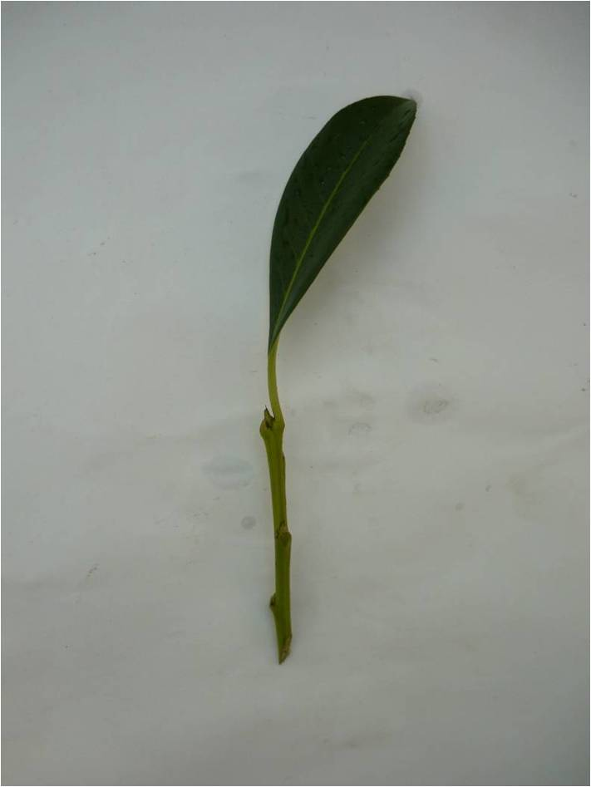
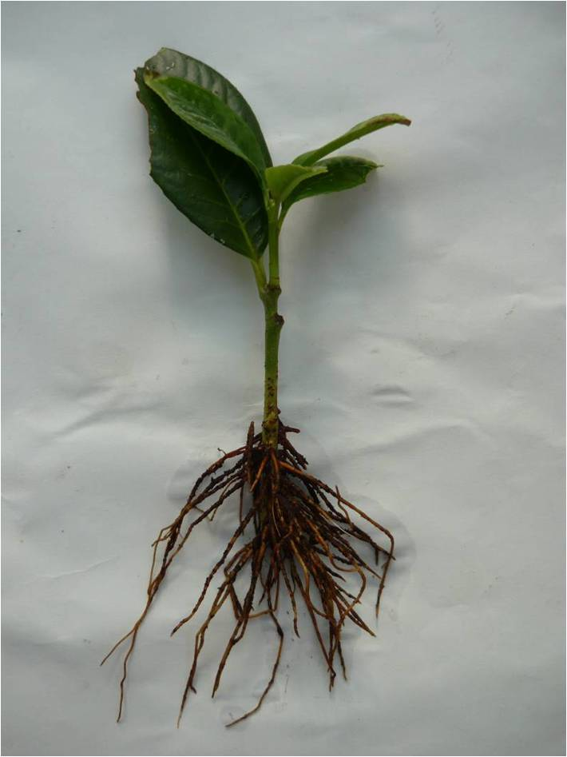
• Cherry laurel is propagated commercially by stem cuttings that are rooted between June and April.
Rooted Cherry laurel stem cuttings
110 days from picking
Cherry laurel stem cuttings

Slide 4
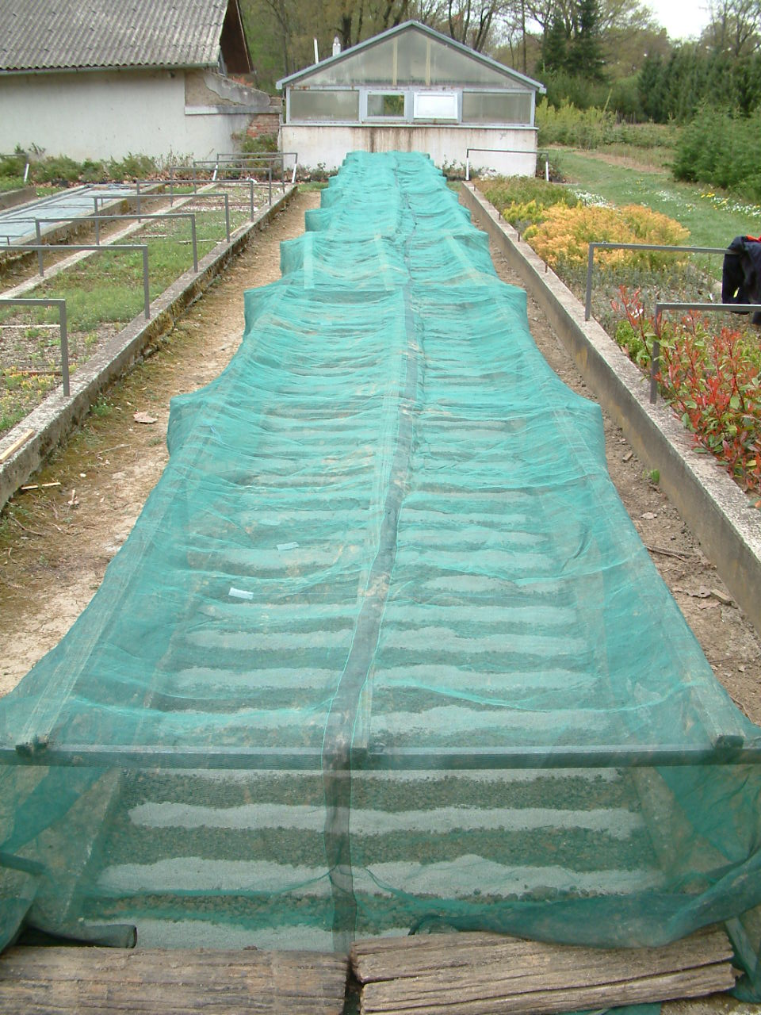
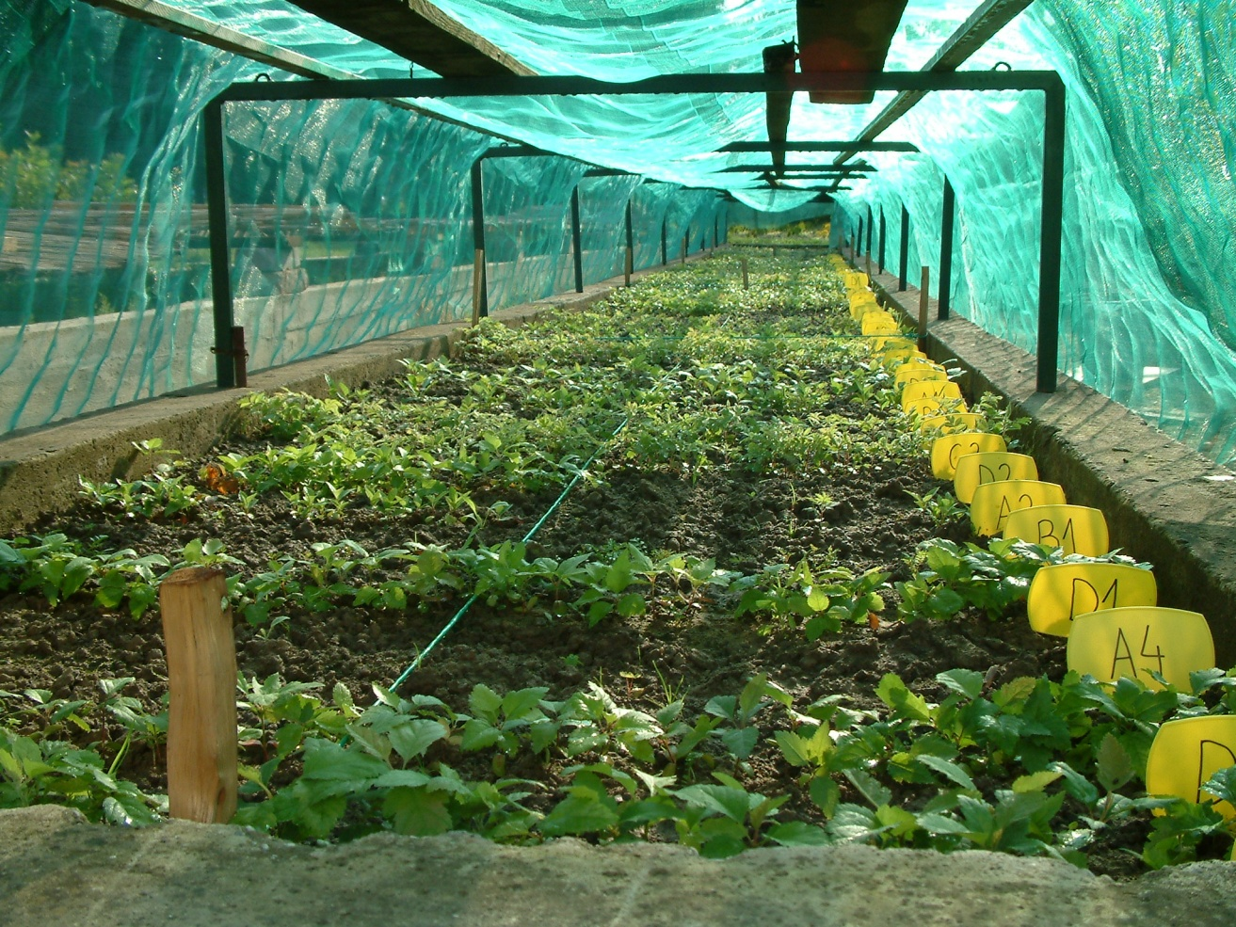
• The use of plastic nets in the nursery production of many ornamental species is considered standard. Plastic nets consists of plastic threads (usually high-density polyethylene) that are woven or knitted to form a regular porous geometric structure through which fluids (gases and liquids) can pass. In this way, the mesh provides physical protection of plants from environmental hazards such as excessive sunlight, hail, wind, frost, and/or flying pests (insects, birds, bats)

Slide 5
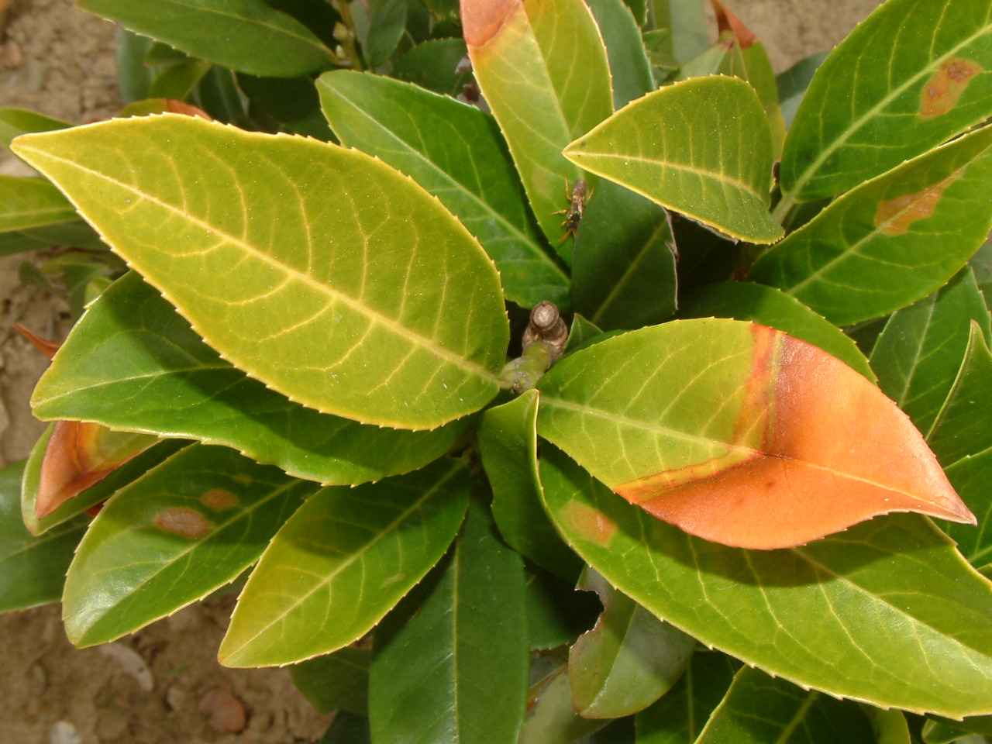
Damage on the leaves from direct sun (western expositions)

Slide 6
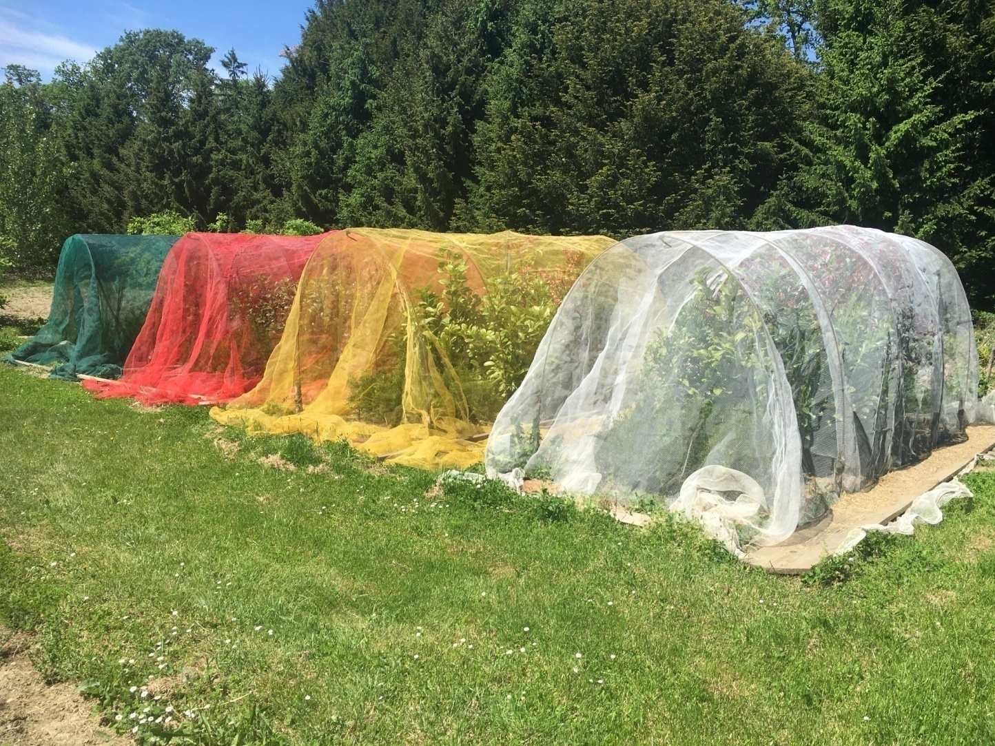
• Photoselective netting is an emerging technology by which the netting is used to modify the quality of the transmitted light, in addition to its basic protective. It was originally developed for ornamental species to create a "smart shade" that outperforms the traditionally used black netting. Because the nets consist of holes in addition to translucent, photoselective plastic filaments, they create a mixture of natural, unmodified light passing through the holes and diffuse, spectrally modified light emitted by the photoselective filaments

Slide 7
• The relative amount of modified versus unmodified light, as well as the shading factor, is determined by the knit design/density and the chromatic and light-dispersive additives.
• Many studies have reported that the application of photoselective netting can differentially affect the vegetative characteristics of ornamental and fruit species.
• Therefore, the objective of this study was to test the ability of different photoselective nets to influence the vegetative characteristics of cherry laurel in a way that increases ornamental value and, consequently, the profitability of cultivation.
MATERIALS AND METHODS
• The study was conducted from 2019 to 2021 in the nursery of the Faculty of Forestry and Wood Technology in Zagreb, Croatia.
• Rooted cherry laurel cuttings from a heated greenhouse were planted 10 x 20 cm apart in in outdoor beds on June 28, 2019.
• Three photoselective nets were used: a white, yellow, and red net (with a mesh size of 2.4 × 4.8 mm) and a standard green shade net (with a mesh size of 1.0 x 2.0 mm) as control. In each treatment, 30 rooted cuttings were transplanted, for a total of 120 cuttings.

Slide 8
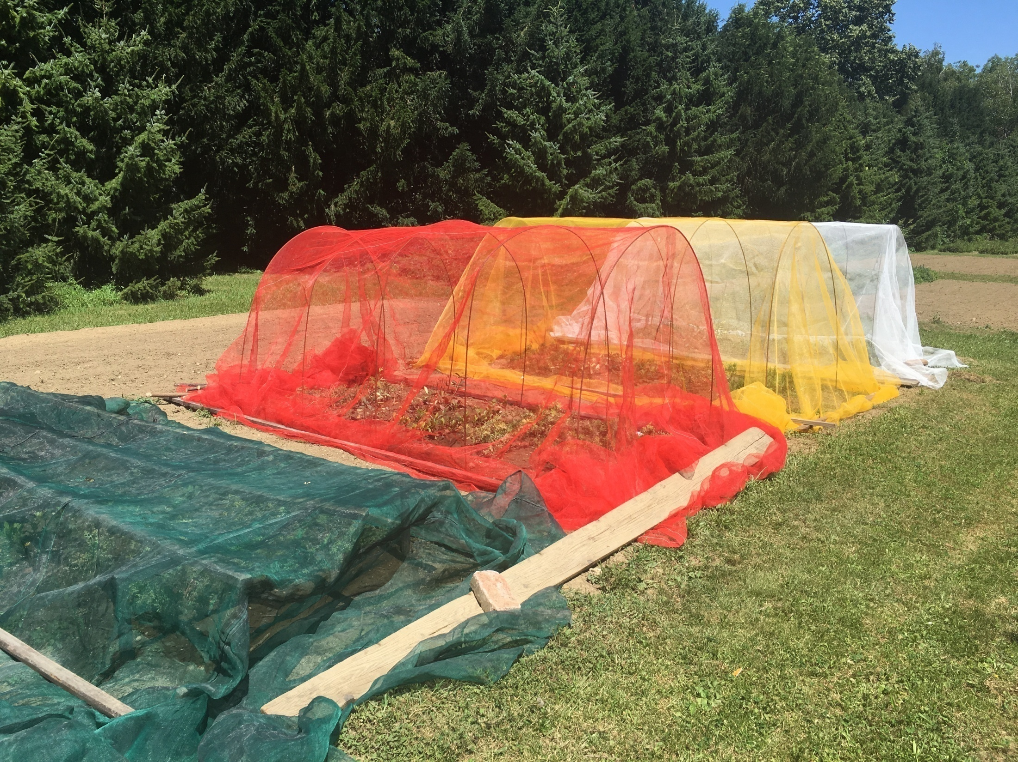
01.07.2019.

Slide 9
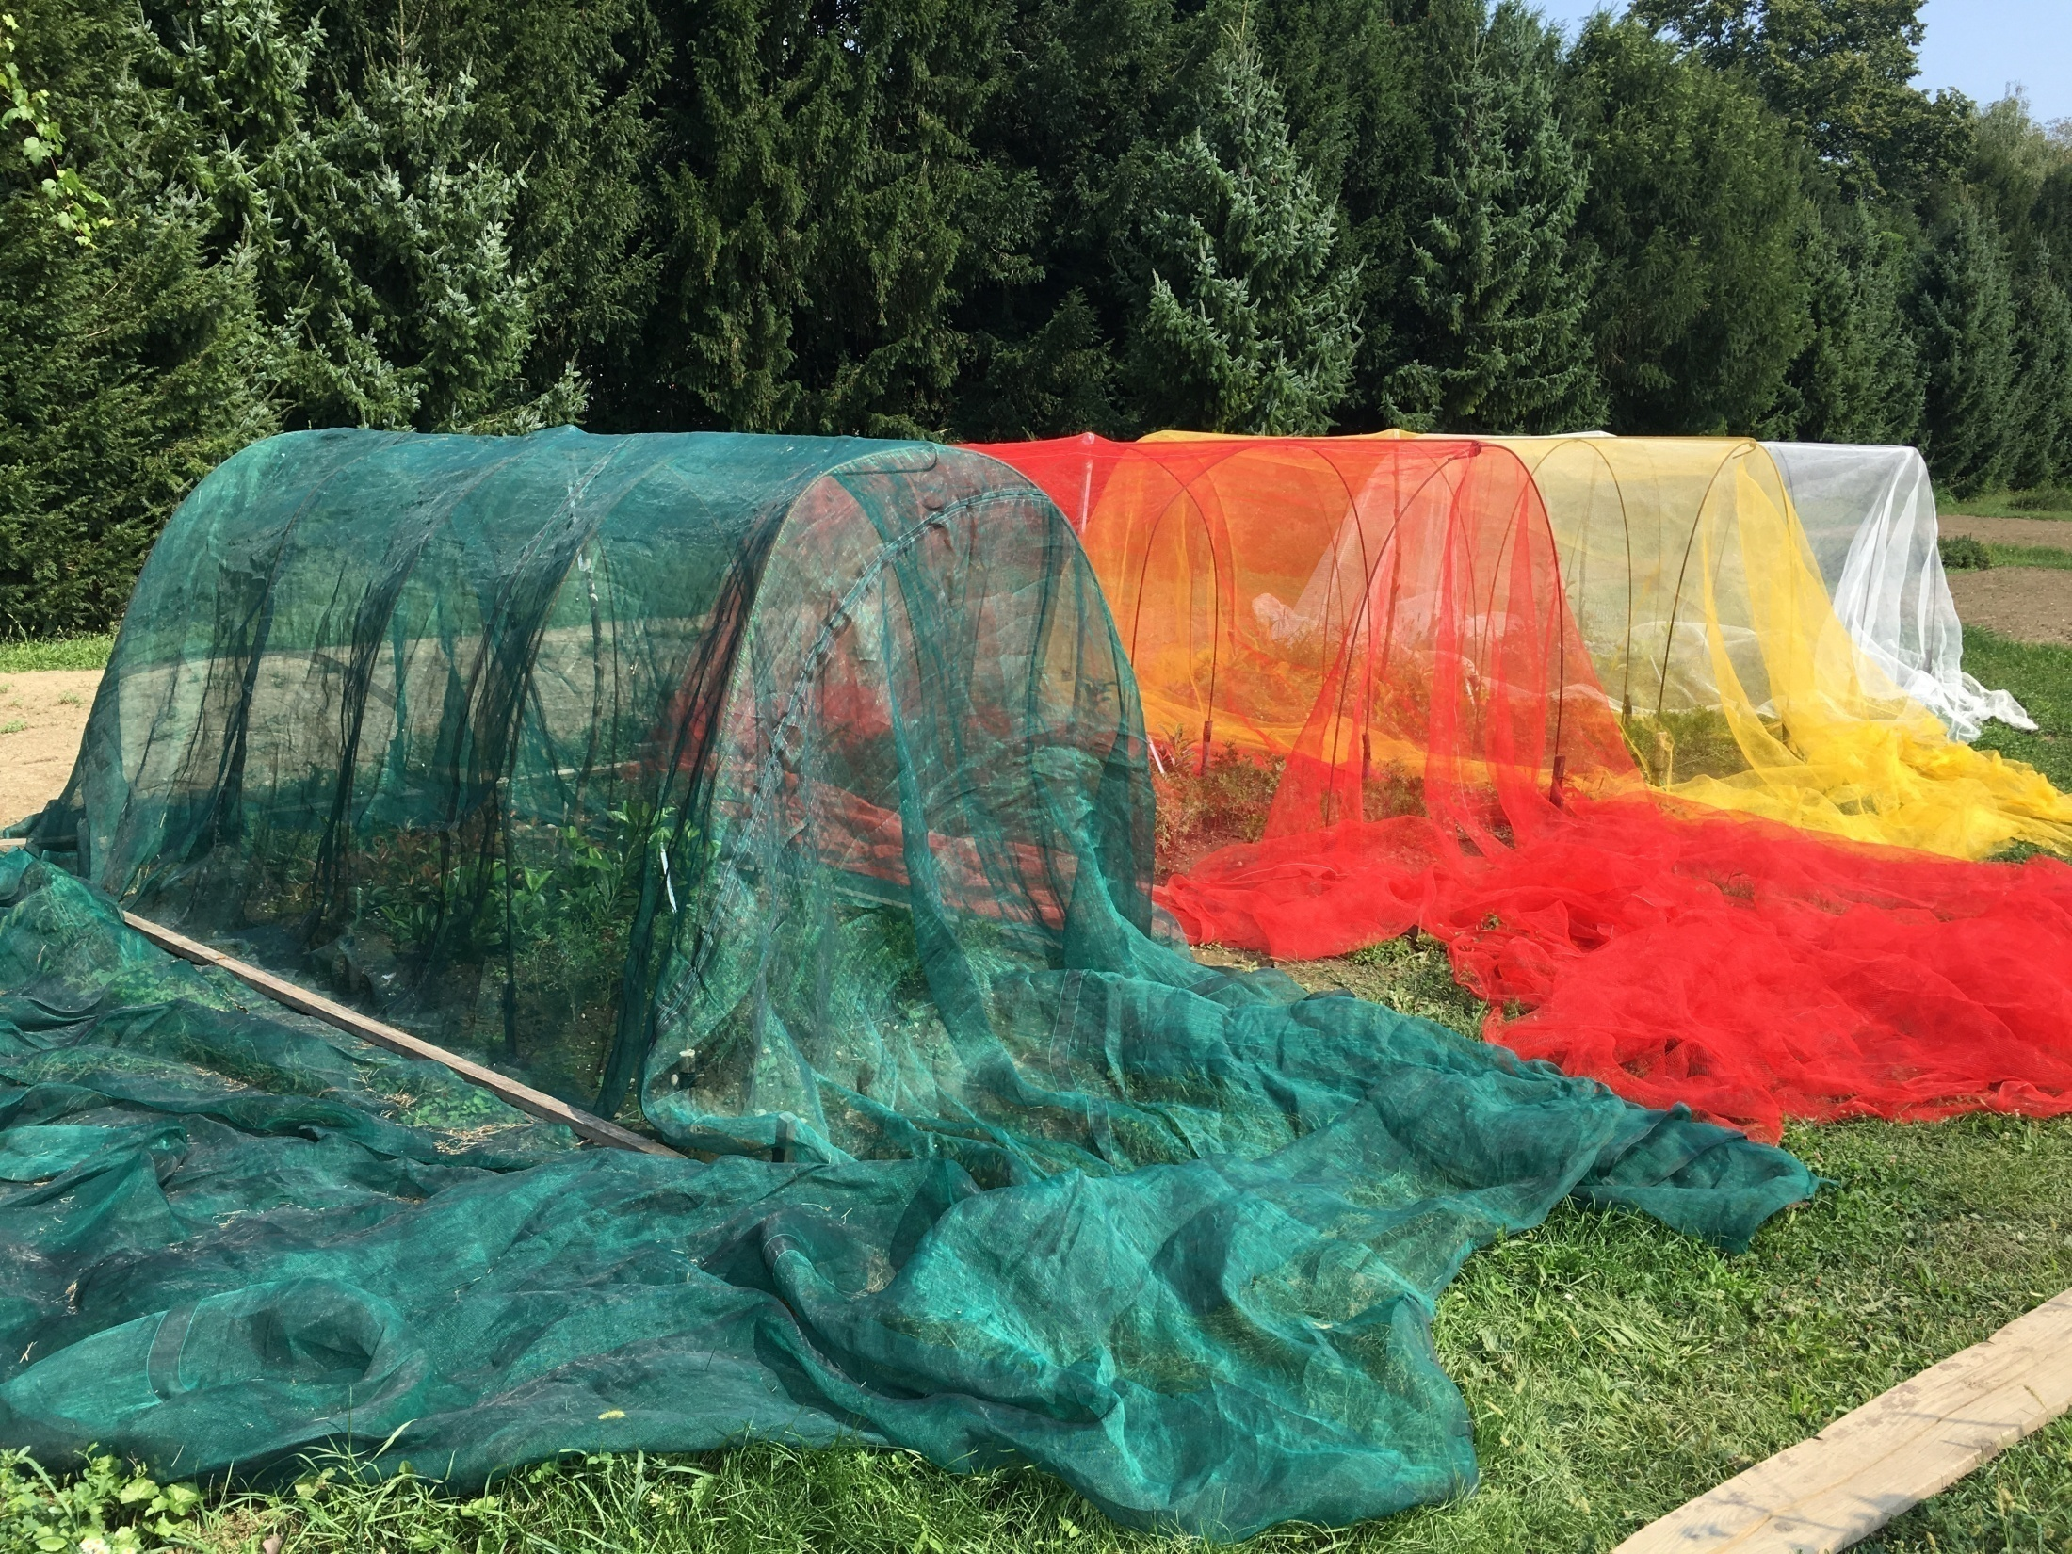
26.08.2019.

Slide 10
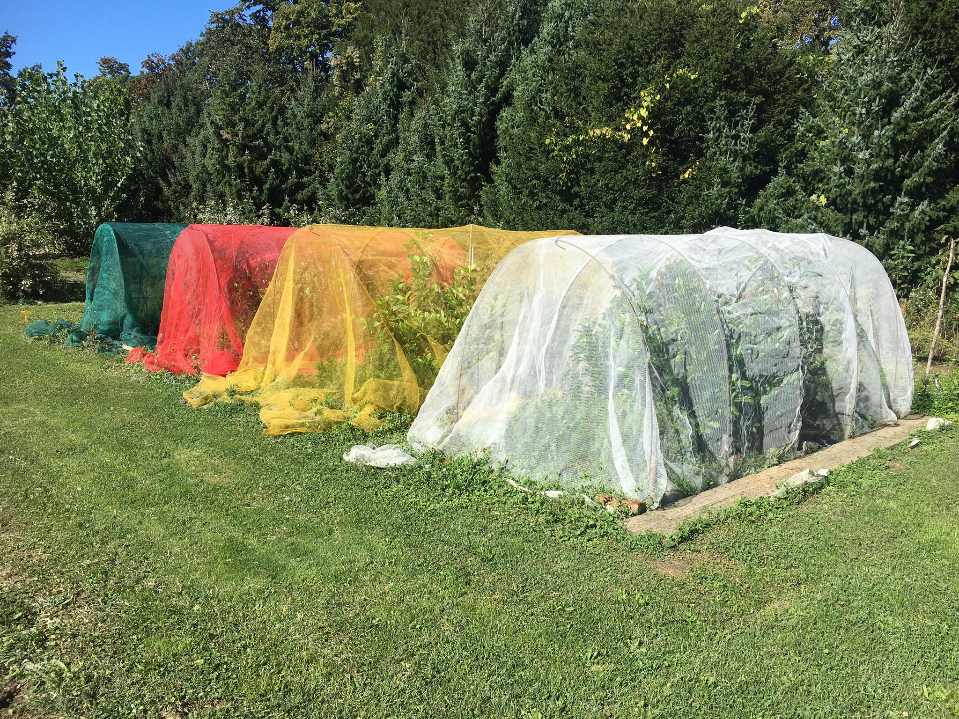
30.09.2020.

Slide 11
• The following morphological variables of cherry laurel were measured: height (cm), root collar diameter (mm), root collar cross-sectional area (TCSA), slenderness coefficient, number of first-stage branches in the lower third of the plant, total number of first-stage branches, total length of first-stage branches in the lower third of the plant (cm), total length of all first-stage branches (cm) and average length of first-stage branches in the middle part of the plant (cm).
• The measurements were performed on June 9, 2021. Root collar diameter was determined by cross measurement using Prowin HMTY0006 digital scroll scale.
• Data were statistically analyzed with SAS Ver. 9.4 statistical software (SAS Institute, NC) using ANOVA and Tukey's HSD test (P ≤ 0.05).
09.06.2021.

Slide 12
RESULTS AND DISCUSSION
• Tables 1 and 2 show that the application of photoselective netting had no significant effect on the all studied vegetative characteristics of cherry laurel.
Table 1. Effect of photoselective nets on height, root collar diameter, root collar cross-sectional area (TCSA), slenderness coefficient of cherry laurel.
Treatment | Height (cm) | Root collar diameter (mm) | TCSA (mm²) | Slenderness coefficient
Green net | 63.93 ± 26.04 a | 13.56 ± 3,68 a | 154.58 ± 78.33 a | 47.53 ± 14.34 a
White net | 63.46 ± 22.31 a | 14.43 ± 5.33 a | 185.02 ± 149.5 a | 39.43 ± 10.16 a
Red net | 68.89 ± 26.65 a | 13.78 ± 4.01 a | 161.23 ± 90.61 a | 45.14 ± 15.03 a
Yellow net | 59.39 ± 24.7 a | 14.82 ± 5.15 a | 192.25 ± 136.79 a | 42.89 ± 7.82 a
¹means followed by the same letter with the same year are not significant according to Tukey’s HSD test at P ≤ 0.05 significance level

Slide 13
Table 2. Effect of photoselective nets on number of first-stage branches in the lower third of the plant (NFSB-LT), total number of first-stage branches (NFSB-T), total length of first-stage branches in the lower third of the plant (LFSB-LT), total length of all first-stage branches (LFSB-T), and average length of first-stage branches in the middle part of the plant (ALFSB-MP)
Treatment | NFSB-LT | NFSB-T | LFSB-LT (cm) | LFSB-T (cm) | ALFSB-MP (cm)
Green net | 2.52 ± 1.90 a | 4.59 ± 3,02 a | 28,97 ± 29.74 a | 55.82 ± 47.50 a | 24.44 ± 24.74 a
White net | 2.68 ± 2.18 a | 4.68 ± 4.19 a | 34.25 ± 37.64 a | 64.04 ± 80.89 a | 25.54 ± 22.89 a
Red net | 2.71 ± 2.14 a | 4.93 ± 4.43 a | 35.61 ± 45.47 a | 71.68 ± 94.04 a | 27.22 ± 29.61 a
Yellow net | 3.07 ± 2.24 a | 4.82 ± 4.17 a | 35.50 ± 29.86 a | 67.27 ± 70.93 a | 27.68 ± 22.84 a
¹means followed by the same letter with the same year are not significant according to Tukey’s HSD test at P ≤0.05 significance level

Slide 14
• Cherry laurel saplings grown under red net had the highest average plant height and total length of all first-stage branches.
• Saplings grown under red and yellow nets had the highest average total length of first-stage branches in the lower third of the plant and the highest average length of first-stage branches in the middle part of the plant.
• Samplings grown under green net had the lowest average TCSA, total length of first-stage branches in the lower third of the plant and total length of all first-stage branches.
• Saplings grown under a yellow net had the lowest average plant height but the highest average root collar diameter and TCSA.
• According to the European Nurserystock Association standard, cherry laurel saplings must have a minimum container volume of 3 L, a minimum height above substrate of 40 cm, a branched shape, and at least three branches in the lower third.
• Only plants grown under the yellow net achieved the desired number of 3 or more branches, but the difference was not significant compared to other nets.
• These results obtained under the red net are probably due to the action of the shadow avoidance mechanism. The results of the shade avoidance mechanism include increased shoot growth and increased apical dominance, which was the case of cherry laurel saplings grown under red net.

Slide 15
CONCLUSIONS
1. Since no significant differences were found in this study, it can be concluded that green shade netting can still be used for cherry laurel saplings in nurseries.
2. However, it should be noted that further studies are needed to test this technology under other agroecological conditions and over several years in order to draw a definitive conclusion.
3. The yellow nets show a promising effect on the quality of cherry laurel saplings, as they promote branching.

Slide 16
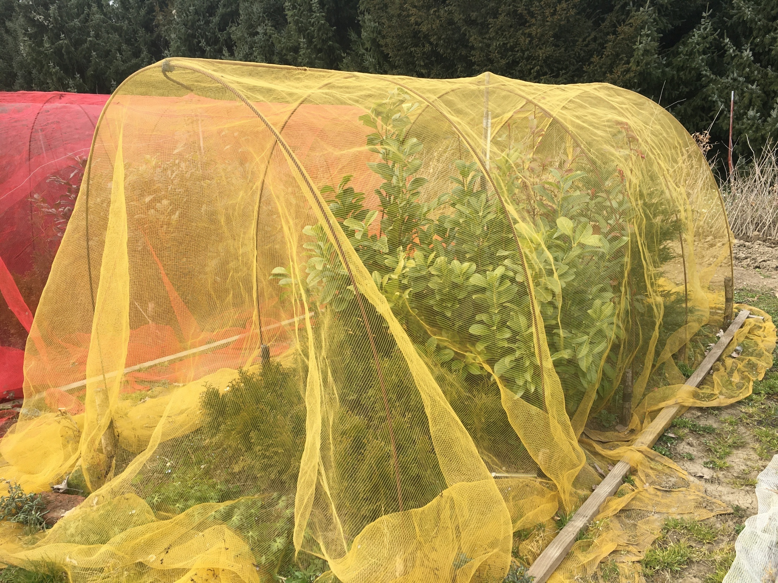
Thank you for your attention !
Contact questions:
drvodelic.damir@gmail.com
ddrvodelic@inet.hr

