Slide 1
QUALITY OF CONTAINER SEEDLINGS OF PEDUNCULATE OAK (Quercus robur L.) OF DIFFERENT AGES
Damir Drvodelić¹, Milan Oršanić¹, Darko Bakšić¹, Ivan Perković¹, Martina Đodan², Martina Jeren Šašek³
Corresponding author's e-mail address: ddrvodelic@inet.hr
1Faculty of Forestry and Wood Technology, University of Zagreb, Zagreb, Croatia
¹Institute of Ecology and Silviculture, Faculty of Forestry and Wood Technology, Zagreb, Croatia
² Croatian Forestry Institute, Jastrebarsko, Hrvatska
²Division of Silviculture, Croatian Forestry Institute, Jastrebarsko, Hrvatska
³W.U. Nursery Koprivnica, Forest Administration Koprivnica, Croatian Forests d.o.o.

Slide 2
INTRODUCTION
• Pedunculate oak is the economically most important species of forest trees, which in the last few decades has become more and more endangered and natural regeneration more and more difficult due to poor seed yield and large intervals between full seeds crop. For this reason, high-quality nursery production of pedunculate oak seedlings is necessary for the artificial restoration of forests according to natural principles.
• In the Republic of Croatia, 19 nurseries of the public forest and forest land management company Croatian Forests d.o.o. are registered, where mandatory professional supervision of the production of forest planting material is carried out (2021).
• The total area of ​​all nurseries is 293.67 ha. The nurseries are territorially located within the Forest Administrations (16) and Work Units (10). Out of a total of 19 nurseries, 6 of them produce pedunculate oak seedlings with bare and coated root systems. These are the nurseries Zalužje (Forest Administration Vinkovci), Višnjevac (Forest Administration Osijek), Zdenački Gaj (Forest Administration Bjelovar), Limbuš (Forest Administration Koprivnica), Lukavec (Forest Administration Zagreb) and Cernik (Forest Administration Nova Gradiška).

Slide 3
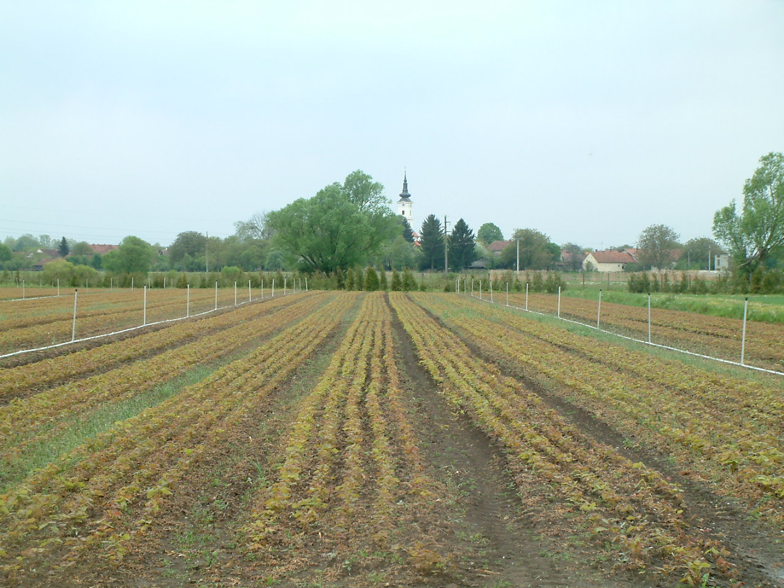
Forest nursery Limbuš (Forest Administration Koprivnica): bare root pedunculate oak seedlings

Slide 4
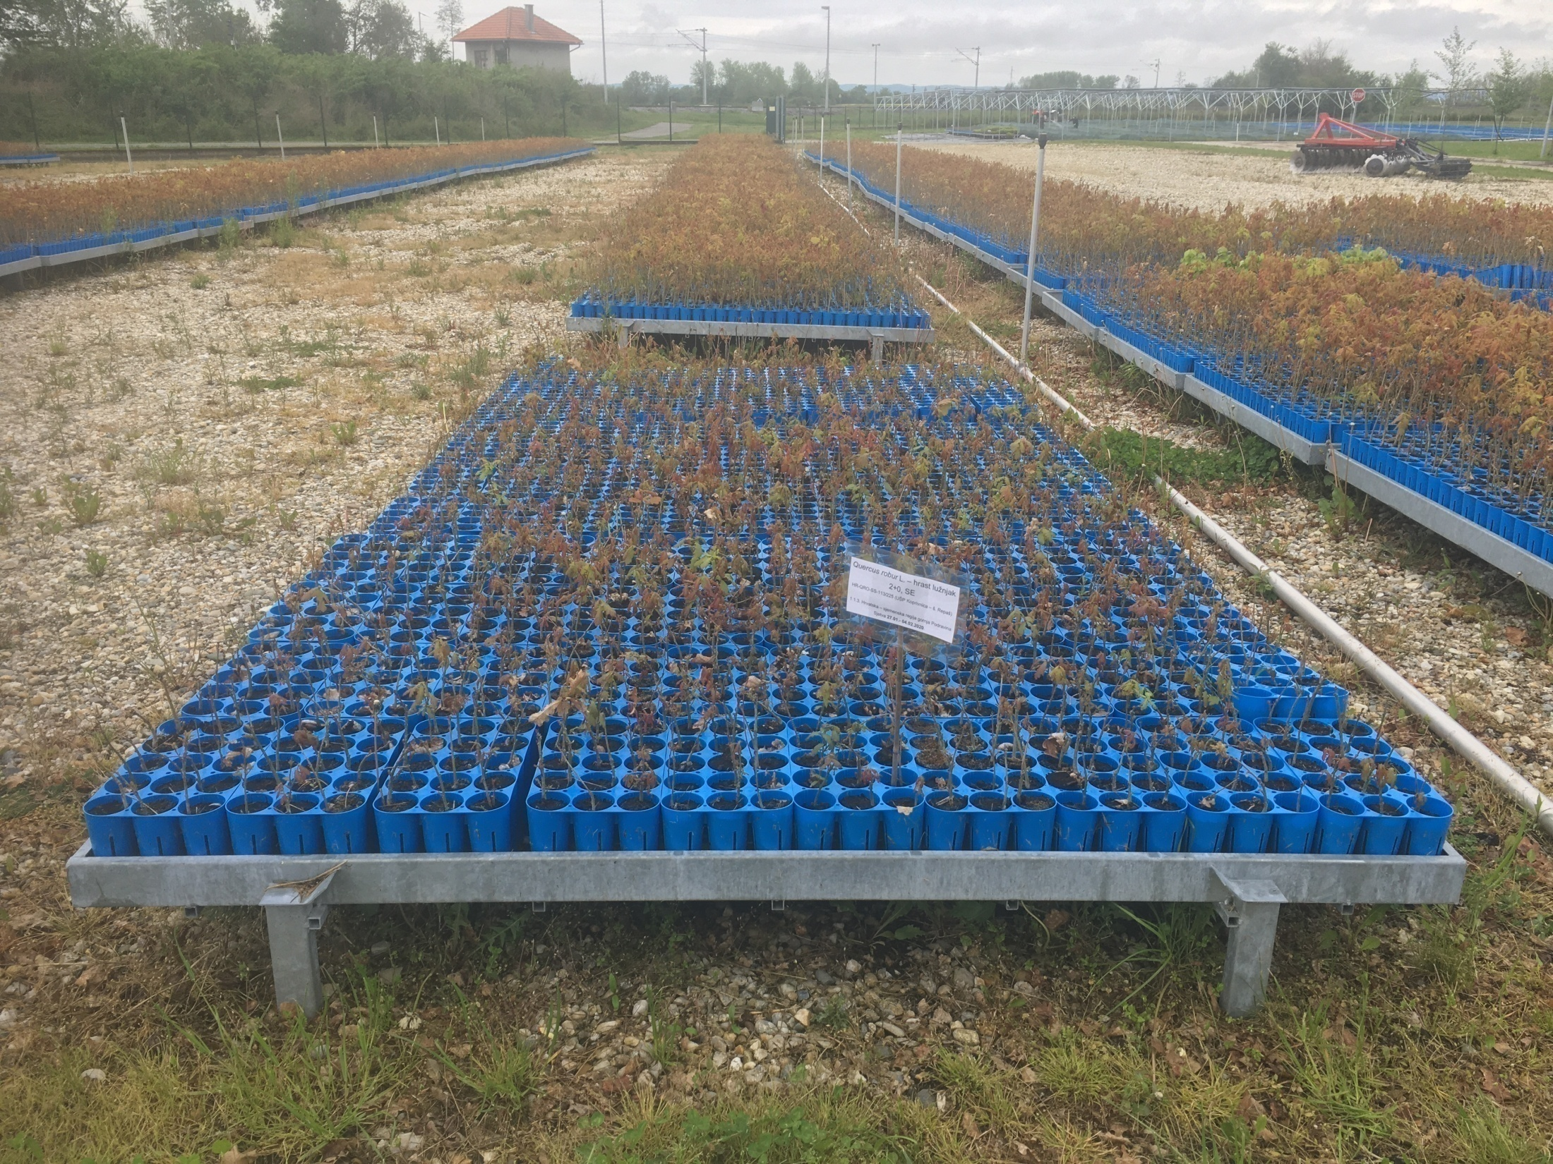
Forest nursery Drnje (Forest Administration Koprivnica): the most modern production facility for sowing seeds and producing forest seedlings of pedunculate oak and other species of coated roots has been installed.

Slide 5
• Currently, there are no registered private nurseries with the production of pedunculate oak seedlings in Croatia.
• The production of forest reproductive material in 2021 for all nurseries was 14,603,756 pieces, of which 12,373,091 pieces or 84.73% of broadleaves seedlings and 2,230,665 pieces of coniferous seedlings or 15.27%.
• In all nurseries, a total of 25 broadleaves species are produced, and the pedunculate oak is in first place (59.70%) in terms of the number of seedlings produced in 2021.
• With regard to the method of growing planting material, the total production of bare-root seedlings in 2021 amounted to 11,388,059 pieces or 92.04%, and coated root 985,032 pieces or 7.96%.
• Out of the total production of 7,385,247 pedunculate oak seedlings in 2021, 7,000,379 bare-rooted seedlings or 94.78% were produced, and 385,868 or 5.22% of coated-root seedlings were produced.
• The aim of this work was to compare the morphological quality of 1+0 and 2+0 coated-root pedunculate oak seedlings produced in a multi-container of the Austrian manufacturer called Lieco V-395 (https://www.lieco.at/en/home/.) and with the help of a modern plant for filling containers and sowing seeds from the Italian manufacturer Urbinati (https://www.urbinati.com/it/.).

Slide 6
MATERIALS AND METHODS
Analysis of container seedlings
• The analysis included 15 randomly selected pedunculate oak seedlings from multicontainers Lieco V-395 at the age of 1+0 and 2+0. The treatments and preparation of the filling substrate of the containers, as well as the type, amount and timing of fertilizer addition were uniformly performed on the automatic filling and seedling line (Urbinati). The following parameters were analyzed on the seedlings and substrate: height, root collar diameter, slenderness coefficient, seedling biomass, root morphological characteristics, substrate pH, and nutrient content (P, K, Ca, Mg, Fe, Mn, Cu, Zn, TC (%), TN (%), C/N ).
• Seedling heights were measured with a ruler from the substrate level to the base of the terminal bud with a precision of 0.0 cm, and the diameter of the root collar diameter was measured at ground level with a digital caliper with a precision of 0.00 mm.
• Morphological features of the root were performed in the Laboratory for Forest Seed and Nursery Production at the Institute of Ecology and Silviculture of the Faculty of Forestry and Wood Technology University in Zagreb. After thoroughly washing the substrate from the roots, using the Epson Expression 10000XL scanner and WinRHIZO ProLA2400 software (2005) for the analysis of washed roots, the eight most significant morphological variables of the root system were determined.

Slide 7
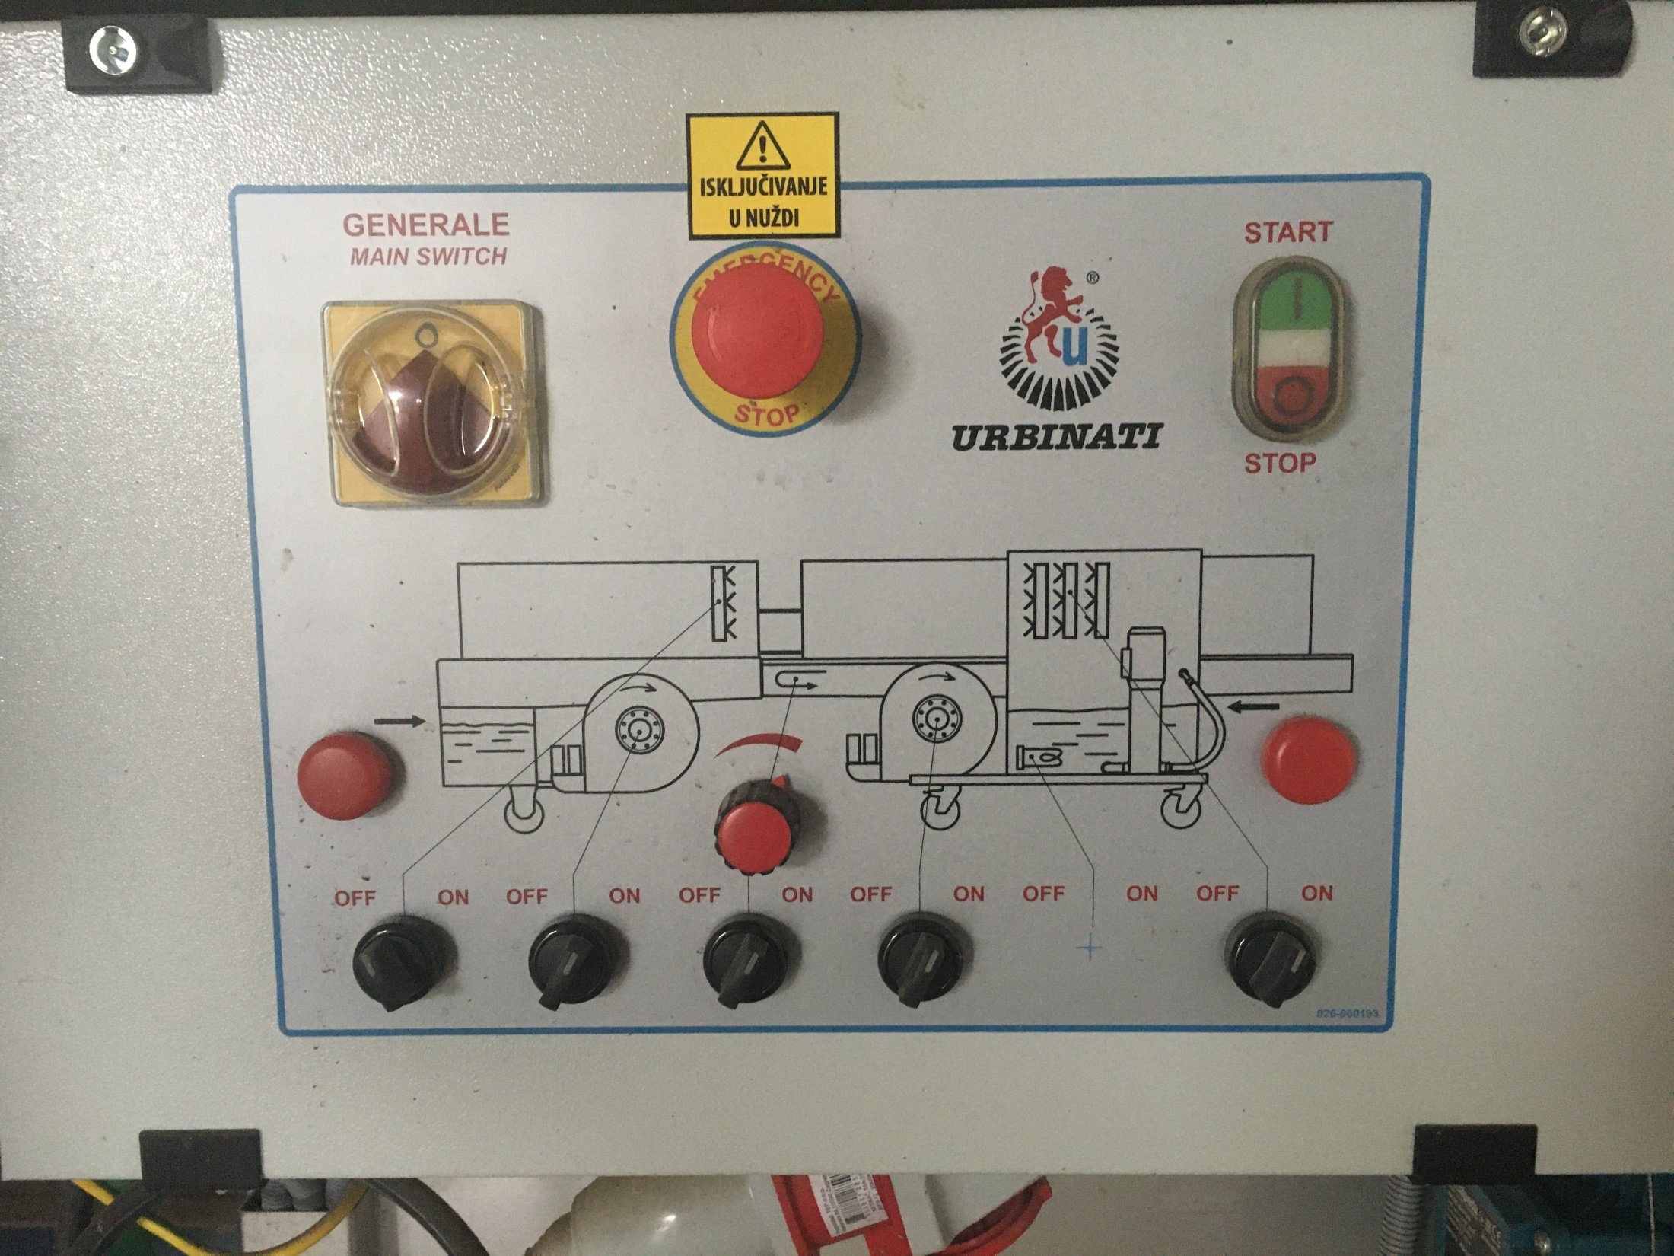

Slide 8
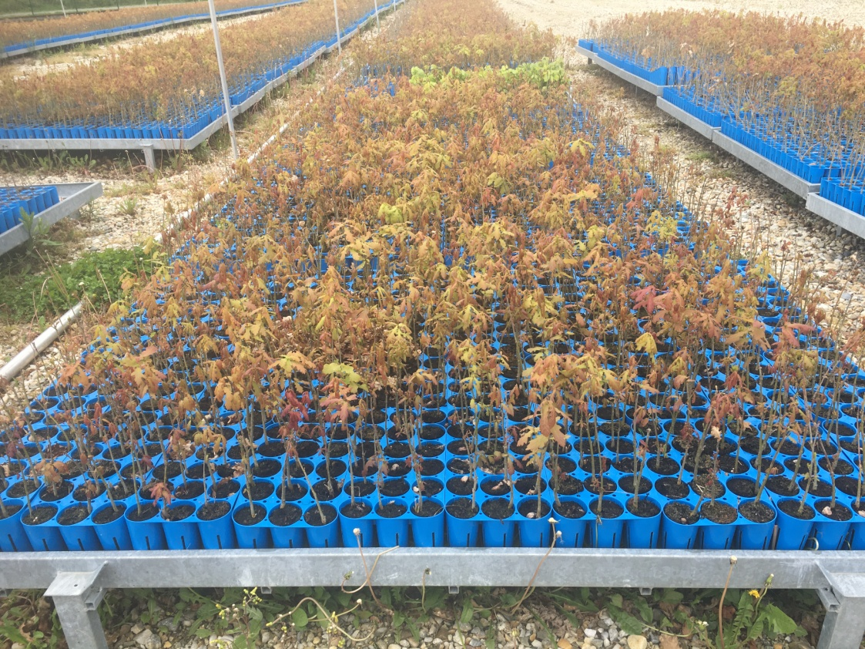
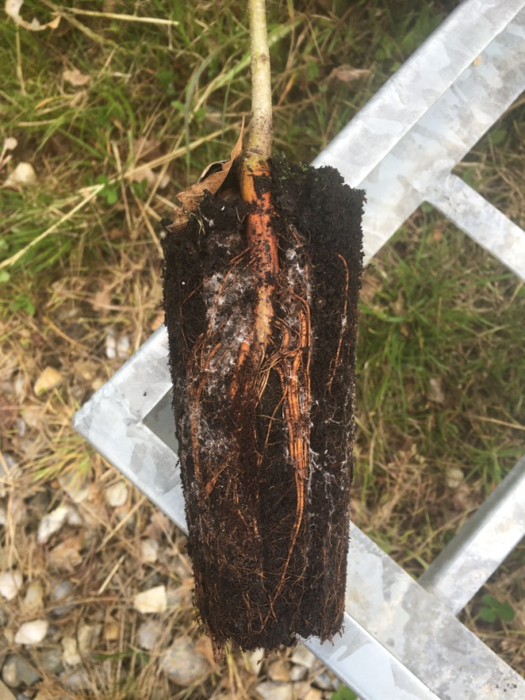
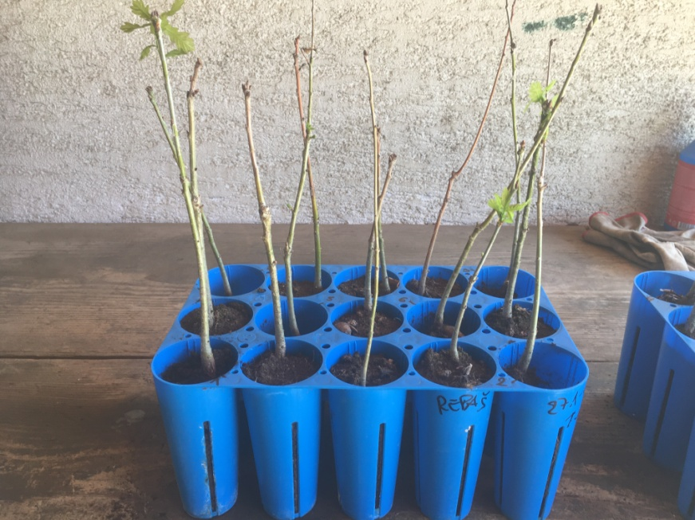
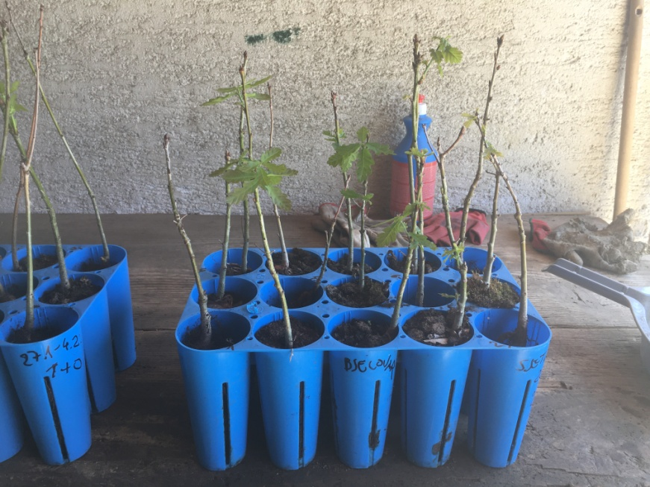

Slide 9
• The moisture content in the stem and root and biomass in the dry state of the stem and root were measured in accordance with the Croatian standard HRN EN ISO 18134-2. This standard has the status of a European standard. A laboratory dryer with forced air flow model Binder RK-980 (BINDER GmbH, 78532 Tuttlingen, Germany) was used to determine the above characteristics. Drying was carried out at a temperature of 105±2°C to a constant mass, which is checked twice, and the difference between the two measurements must not exceed 0.2%. Biomass in the dry state was determined separately for stem and root, and from this the stem/root biomass ratio was calculated.

Slide 10
Analysis of containers substrate
• pH_{H2O} – Determination of pH (HRN ISO 10390:2005)
• pH_{CaCl2} – Determination of pH (HRN ISO 10390:2005)
• Determination of dry matter and water content on a mass basis – Gravimetric method (HRN ISO 11465:2002)
• TC and OC – Determination of total and organic carbon (HRN ISO 10694:2004)
• TN – Determination of total nitrogen (HRN ISO 13878:2004)
• CaCO₃ – Determination of Carbonate content – Volumetric method (HRN ISO 10693:2004)
• Extraction of soil nutrients using Mehlich-3 reagent– mesurement by ICP-AES Thermo Fisher iCAP 6300

Slide 11
RESULTS WITH DISCUSSION
• The average height of seedlings 1+0 was 24.2 cm, root collar was 7.40 mm, and the slenderness coefficient was 3.37. The average height of seedlings 2+0 was 20.0 cm, root collar was 7.23 mm, and the slenderness coefficient was 2.82. A statistically significant difference was found between the seedling heights of 1+0 and 2+0.

Slide 12
• No statistically significant difference was found in the root collar diameter of the seedlings and the slenderness coefficient.

Slide 13
• The average biomass of seedlings 1+0 was 2.28 g, roots 5.90 g, and stem/root ratio 0.40. The average stem biomass of seedlings 2+0 was 1.93 g, roots 6.00 g, and stem/root biomass ratio 0.32.
• No statistically significant difference was found between the biomass of stems, roots and slenderness coefficient of seedlings 1+0 and 2+0

Slide 14
• Eight more important morphological features of the root system of 1+0 and 2+0 pedunculate oak seedlings
s.d.
s.d.
s.d.
Age of seedlings | Length (cm) | ProjArea (cm²) | SurfArea (cm²) | Average diameter (mm) | Volume (cm³) | Tips (psc) | Forks (pcs) | Crossings (pcs)
1+0 | 903,73 | 93,08 | 292,40 | 1,23 | 8,50 | 1585 | 11467 | 1312
2+0 | 1108,94 | 90,27 | 283,58 | 0,82 | 5,90 | 2301 | 11776 | 1325

Slide 15
• A statistically significant difference was found between seedlings 1+0 and 2+0 in the following root variables: average diameter (mm), volume (cm³), and number of tips (psc).

Slide 18
• There is a significant difference in the content of Cu, K, Mg, Mn, P, TN (%) and C/N in the substrate, which may also indicate inhomogeneous filling that should be further controlled to improve seedling quality.
-2+0
+2+0
+2+0
+2+0
+2+0
-2+0
+2+0
Age of seedlings | pHH₂0 | pHCaCl₂ | Cu | Fe | K | Mg | Mn | Na | P | Zn | TC (%) | TN (%) | C/N
1+0 | 7,84 | 7,16 | 19,4 | 165,4 | 126,1 | 1091,7 | 12,8 | 60,3 | 14,0 | 6,9 | 45,27 | 0,94 | 48
1+0 | 7,58 | 7,14 | 13,9 | 128,1 | 128,1 | 1102,7 | 5,2 | 66,9 | 11,9 | 16,7 | 45,62 | 1,03 | 44
1+0 | 7,77 | 7,22 | 12,4 | 177,1 | 141,1 | 1113,7 | 12,3 | 78,8 | 12,6 | 17,6 | 45,28 | 0,95 | 48
1+0 | 7,75 | 7,2 | 19,7 | 184,5 | 185,9 | 1127,7 | 14,1 | 88,6 | 23,2 | 56,5 | 44,94 | 1,23 | 37
1+0 | 7,72 | 7,15 | 21,8 | 238,4 | 127,1 | 1107,7 | 18,3 | 64,4 | 22,9 | 10,1 | 45,44 | 1,21 | 38
1+0 | 7,88 | 7,22 | 17,4 | 215,1 | 132,5 | 1117,7 | 15,2 | 57,8 | 15,1 | 19,4 | 45,41 | 1,15 | 39
2+0 | 7,66 | 7,11 | 12,3 | 200,9 | 249,0 | 1188,7 | 25,7 | 62,4 | 60,7 | 28,7 | 45,19 | 1,35 | 33
2+0 | 7,82 | 7,18 | 10,9 | 181,8 | 236,0 | 1153,7 | 19,2 | 47,4 | 38,3 | 22,7 | 44,94 | 1,39 | 32
2+0 | 7,64 | 7,06 | 10,6 | 208,0 | 263,6 | 1166,7 | 22,4 | 48,4 | 60,1 | 60,8 | 45,33 | 1,38 | 33
2+0 | 7,85 | 7,21 | 9,2 | 168,7 | 263,6 | 1155,7 | 19,5 | 44,7 | 59,4 | 61,8 | 45,46 | 1,40 | 32
2+0 | 7,66 | 6,99 | 9,7 | 191,6 | 175,2 | 1162,7 | 21,6 | 36,6 | 80,4 | 45,4 | 45,41 | 1,40 | 33
2+0 | 7,15 | 6,41 | 10,5 | 219,1 | 314,1 | 1144,7 | 25,6 | 76,8 | 80,2 | 34,9 | 46,96 | 1,69 | 28

Slide 26
CONCLUSIONS
A statistically significant difference was found between the seedling heights of 1+0 and 2+0.
A statistically significant difference was found between seedlings 1+0 and 2+0 in the following root variables: average diameter, volume, and number of tips.
There is a significant difference in the content of Cu, K, Mg, Mn, P, TN (%) and C/N in the substrate, which may also indicate inhomogeneous filling that should be further controlled to improve seedling quality.
Due to the limited volume, Lieco V-395 containers are not recommended for growing seedlings 2+0.

Slide 27
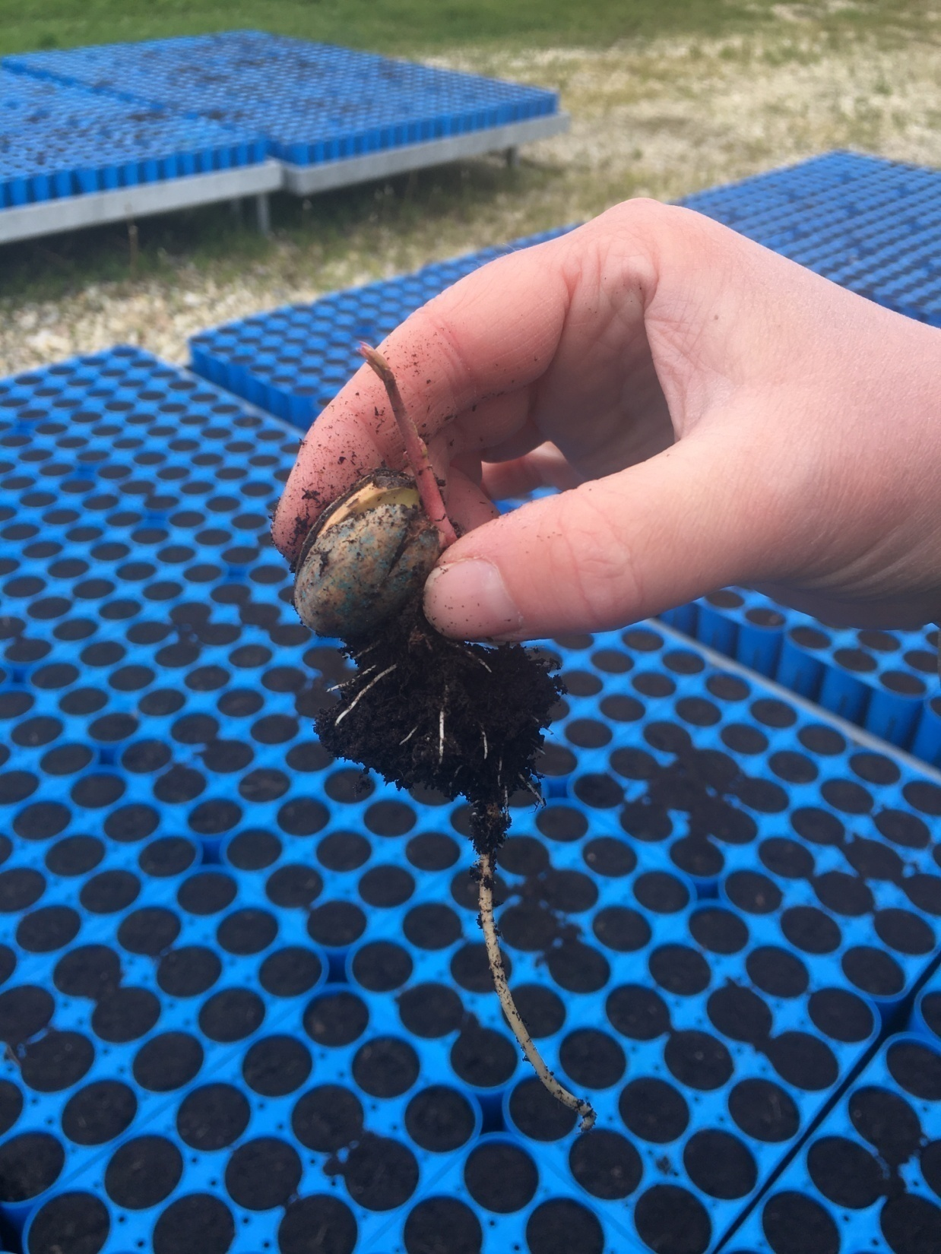
Thank you for your attention !
Contact questions:
drvodelic.damir@gmail.com
ddrvodelic@inet.hr

