Slide 1
INFLUENCE OF EXTREME AIR TEMPERATURES ON SEED
GERMINATION OF SWEET WORMWOOD (Artemisia annua L.)
Damir Drvodelić
University of Zagreb Faculty of Forestry and Wood Technology
Institute of Ecology and Silviculture
Svetošimunska cesta 23, 10000 Zagreb, Hrvatska
Corresponding author: ddrvodelic@inet.hr
NATURAL RESOURCES, GREEN TECHNOLOGY
& SUSTAINABLE DEVELOPMENT/4
14th and 16th September 2022
Hotel International, Zagreb, Croatia

Slide 2
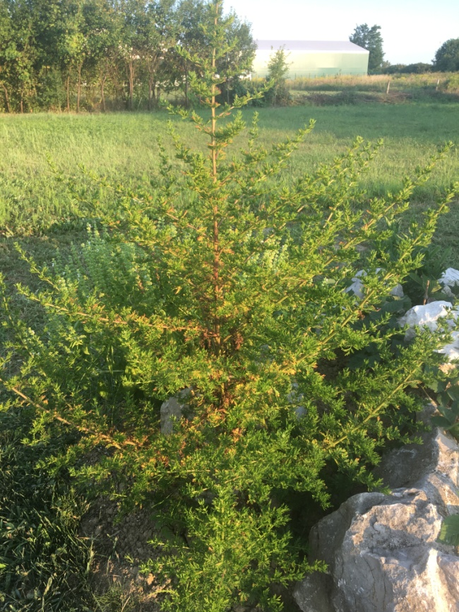
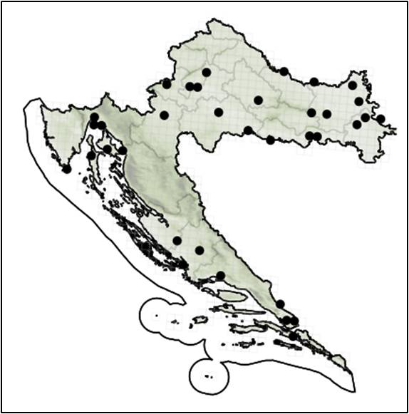
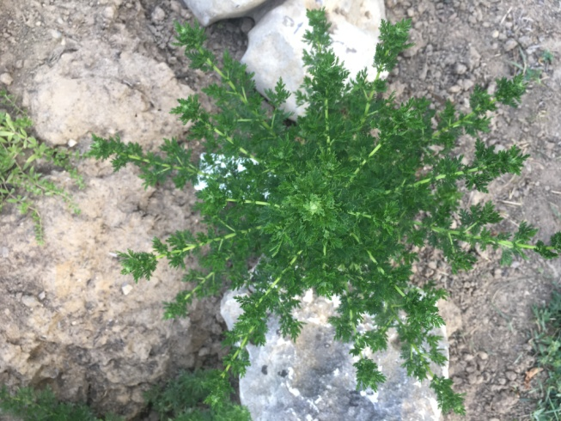
INTRODUCTION
About 520 species of the genus Artemisia L. are known in the world, while only 17 species and subspecies grow in Croatia. Sweet wormwood is an annual herbaceous plant 50 to 150 cm tall.
Distribution of sweet wormwood in the Republic of Croatia (source: Nikolić, 2021)

Slide 3
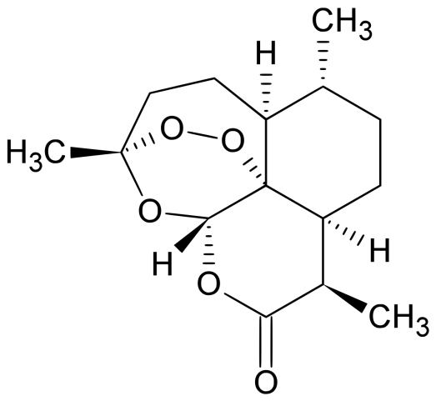
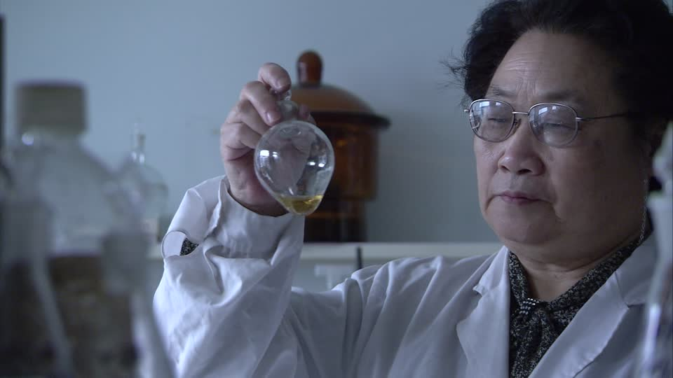
The medicinal properties of sweet wormwood have long been known and medically proven, especially in the treatment of malaria in Africa, Asia and Europe.
Sweet wormwood artemisinin brought researchers the 2015 Nobel Prize in Medicine.
Tu Youyou
The molecular formula of artemisinin

Slide 4
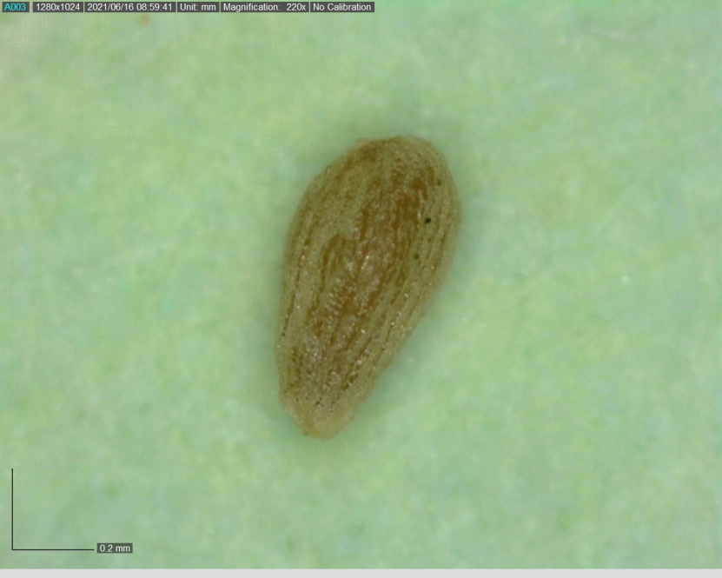
In Croatia, sweet wormwood belongs to the group of non-native flora, naturalized species with numerous fortified sites from east to south. The seeds are very small, weighing an average of 2.7x10-⁵ g. It belongs to the group of microbiotic, Orthodox, positive photoblastic seeds with epigeic germination and a germination percentage of 79%. Almost all seeds germinate within 7 days.
Seed of sweet wormwood

Slide 5
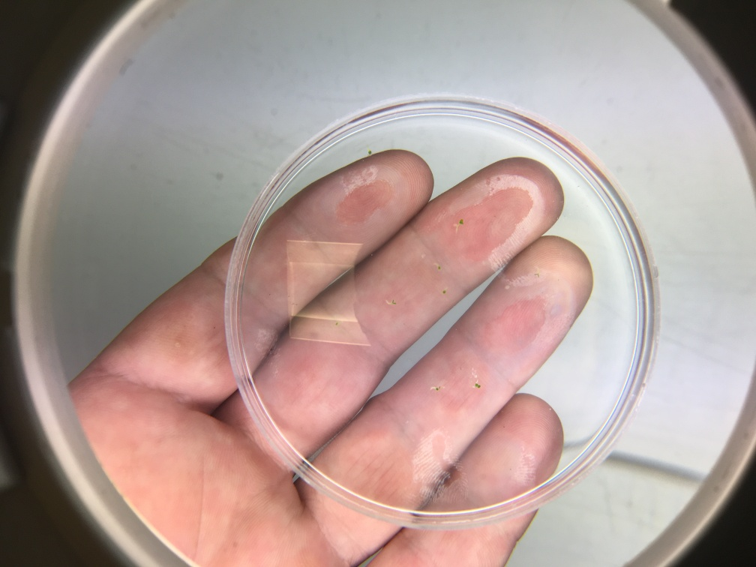
AIM OF THE STUDY
Given the global climate change and the increasing occurrence of extreme temperatures and their duration, the aim of the study was to determine the impact of extremely low (-40 °C) and extremely high (+60 °C) air temperatures on seed germination.
MATERIALS AND METHODS
The seeds were treated at a temperature of -40 °C and +60 °C for 72 hours before germination in distilled water in PVC Petri dishes. Seed germination was recorded every day, for a total of seven days.

Slide 6
RESULTS
Seeds treated at high temperatures after two days began to germinate in terms of penetrating the radicals through the seed coat in a higher percentage compared to seeds treated at low temperatures. The results of this study show greater adaptability of sweet wormwood seeds to higher temperatures and, accordingly, greater potential of habitat suitability for growth in the event of an increase in average temperatures, temperature extremes and heat waves. On the seventh day, the seeds treated at high temperatures had the same germination as on the fourth day in the amount of 90%. All seedlings were regular developed.
Legend:
Treatment A: +60 °C, 72 hours
Treatment B: -40 °C, 72 hours
Control seeds

Slide 7
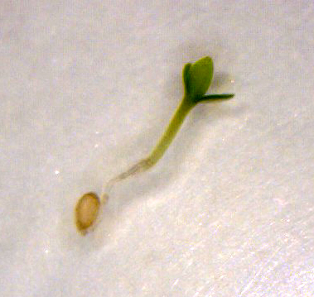
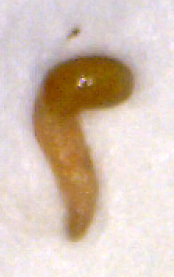
There were 6.67% of brown rotted seedlings and 3.33% of non-germinated seedlings. On the seventh day, seeds treated at low temperatures had a germination of 83.33% or 6.66% more than on the fourth day. The germination of control seeds was 90%, with all seeds germinating on the third day.
Seedling of sweet wormwood with two cotyledons and one primary leaf grown from treatment A (+60 °C, 72 hours ) taken on the fourth day after sowing
Rotten and abnormal seedling of sweet wormwood
CONCLUSIONS
Considering that some authors write about the weed and invasive character of sweet wormwood in some areas, which has not been recorded in Croatia so far, the results of this research are in favor of increasing the habitat suitability for this species in the future.
Keywords: Artemisia annua, artemisinin, climate changes, seed germination, sweet wormwood

