Slide 1
Selection of genotypes of Service tree (Sorbus domestica L.) with regard to seed quality
Damir Drvodelić
Corresponding author's e-mail address: ddrvodelic@inet.hr
Faculty of Forestry and Wood Technology, University of Zagreb, Zagreb, Croatia
Institute of Ecology and Silviculture, Faculty of Forestry and Wood Technology, Zagreb, Croatia

Slide 2
INTRODUCTION
• One of the oldest documents in which the name of service tree is mentioned is the Charter of Duke Koloman from 1240, declaring the medieval Petrinja a free city. The service tree is mentioned when describing land boundaries.
• Service tree is an autochthonous forest fruit tree in the Republic of Croatia that naturally grows in the Eumediterranean zone and in Istria, Primorje (marginal zone), Dalmatia (all the way to the south, all larger Adriatic islands), and on the continent it has been anthropogenically expanded and planted more than any other forest fruit tree along the vineyards, roads, on the land borders, on the edges of forests and in today's old and mostly abandoned orchards.
• In the Forest Order of Maria Theresa from 1769. in Croatian, it says how to refer to the forest. In fact, it is the first textbook on forest cultivation and turning points in the relationship between man and forest in these areas. The ruler Marija Terezija issued an order that every country yard must be planted with service tree, pear tepka and apples bobovac, carević, kanada, mošancel and others apples because of hunger and healthier nutrition for children and the population.

Slide 3
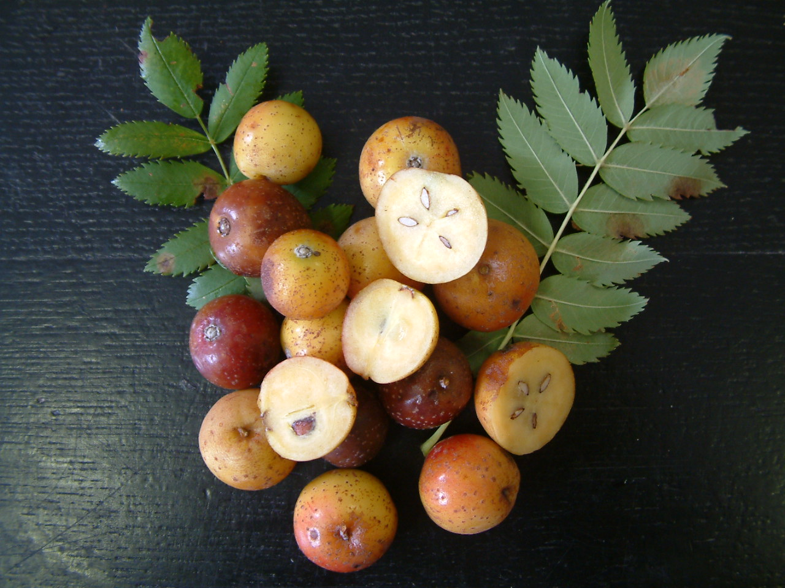

Slide 4
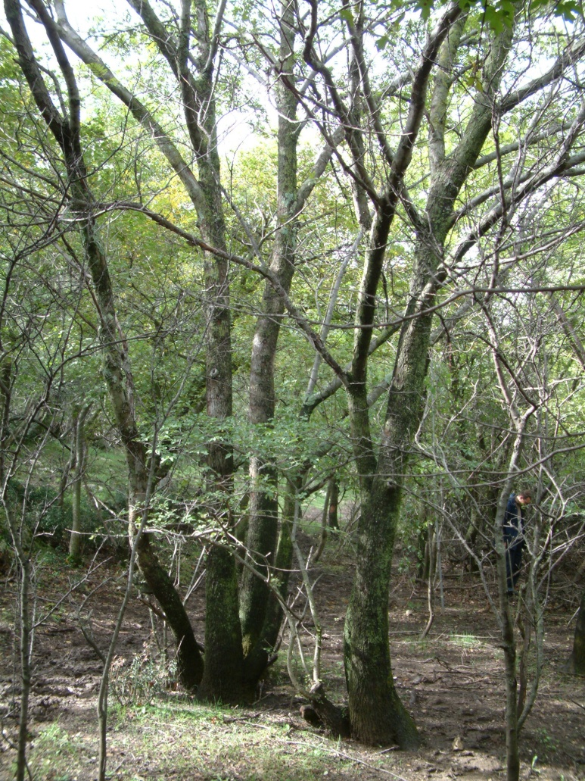
• Some service trees from that period are still alive in old and abandoned orchards and in a very poor health (biological) and mechanical (static) condition due to continuous neglect due to ignorance of their value and especially today in the light of global climate change (they tolerate summer droughts and lack of rainfall), lack of organic fruit and its high prices, as well as food in general due to war and other crisis situations in the world. Service tree does not require special protection and can be grown in a completely ecological way.
• In the last 20 years (2002-2022), I have been conducting an inventory of all adult service trees in the Republic of Croatia, and so far about 300 trees with GPS coordinates have been registered, with the assumption that there are up to 500 of them. The trees most often grow on private properties, in abandoned orchards, along vineyards, roads, on the borders, edges of forests, while they are very rare within the forest stand as trees from seeds. Stump trees are more common in the Mediterranean area.
Stump service trees in submediterranean area in Croatia

Slide 5
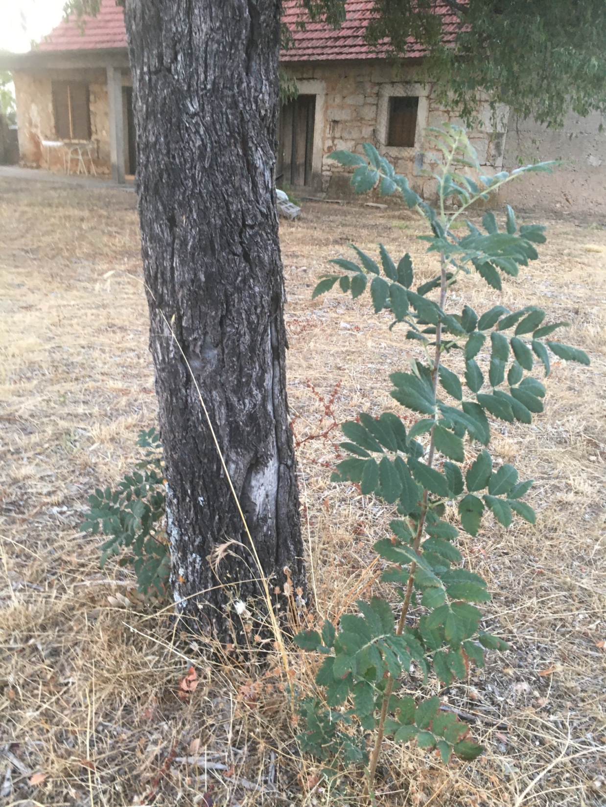
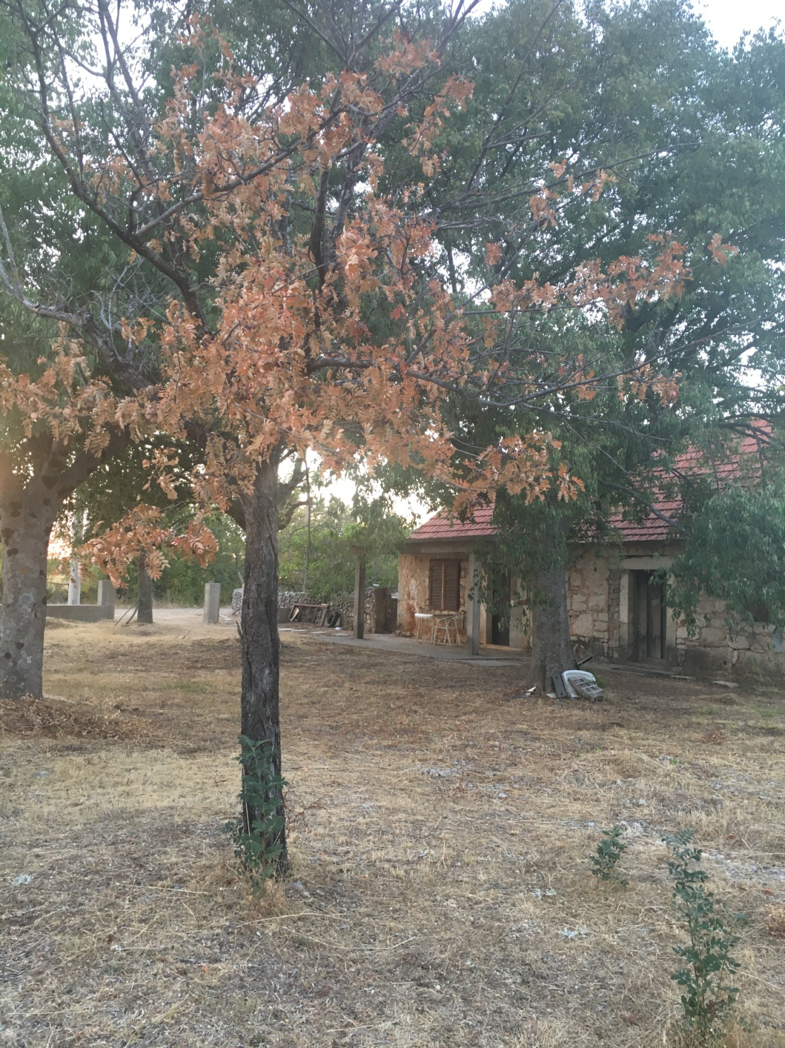
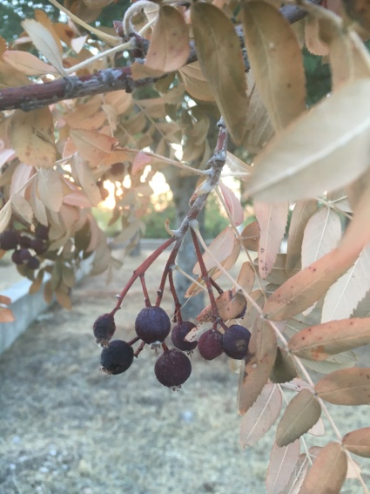
Many vital root suckers after dead of the mother service tree in Miljevci near Drniš

Slide 6
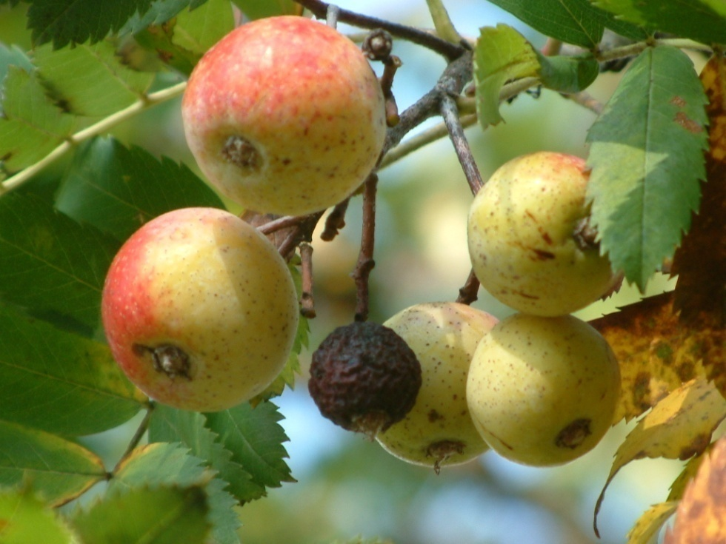
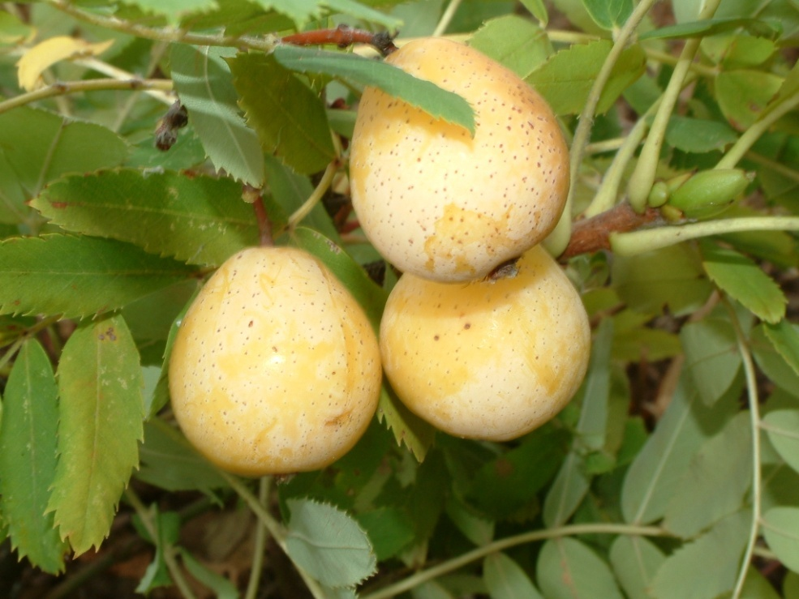
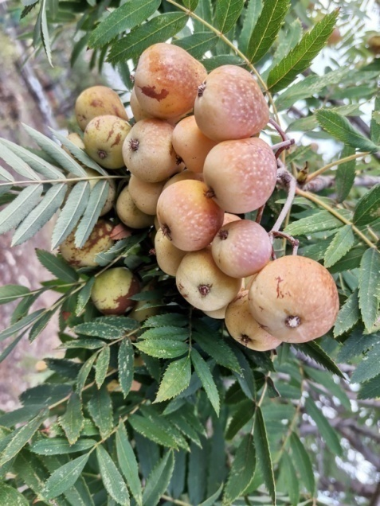
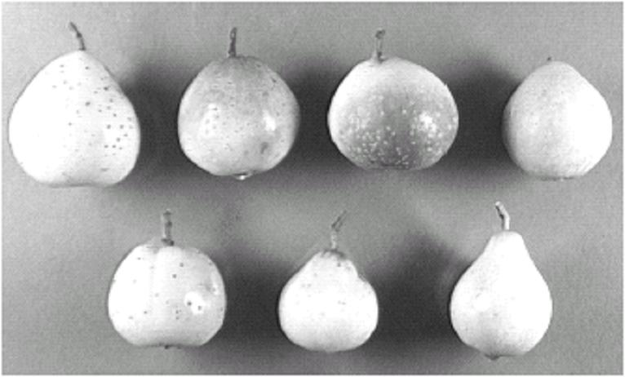
• According to the shape of the fruit, the apple-shaped form (f. pomifera) is the most common. The pear-shaped form (f. pyrifera) very rare like other forms like plum-like and others. Forms of the other basic color of the fruit (red, wine color, light brown, etc) exist although they are very rare.
f. pomifera
f. pyrifera
Light brown service tree fruits (Ilovik)
Shape of the fruit
• The largest service tree in Croatia grows on Papuk with a perimeter of 357 cm (DBH 114 cm) and belongs to the veteran tree of which there are few.

Slide 7
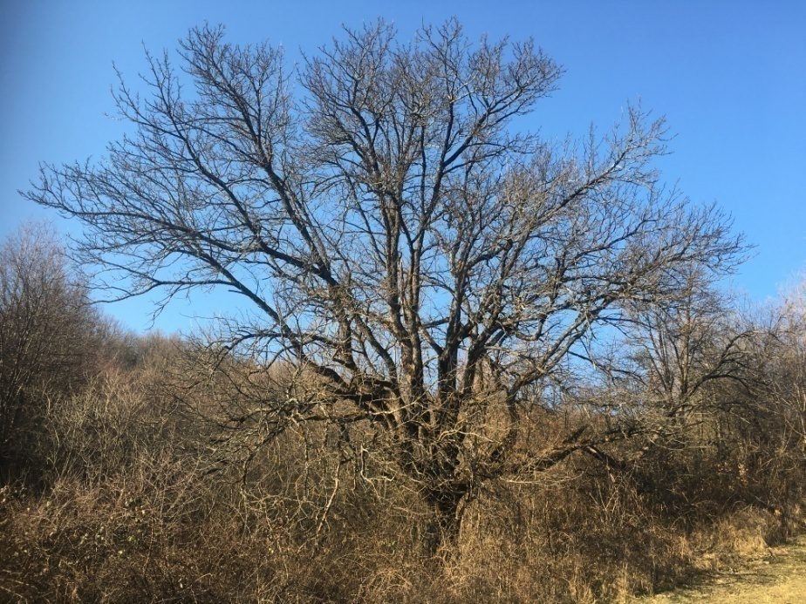
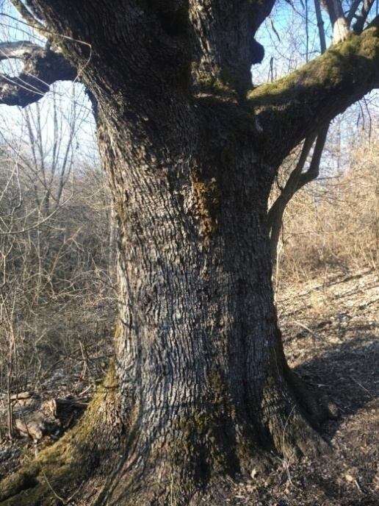
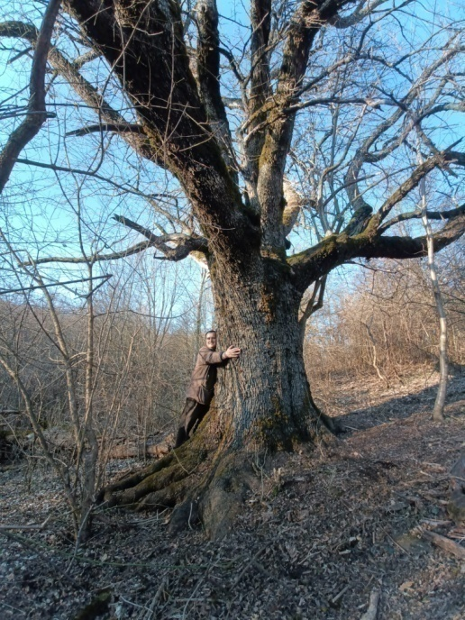
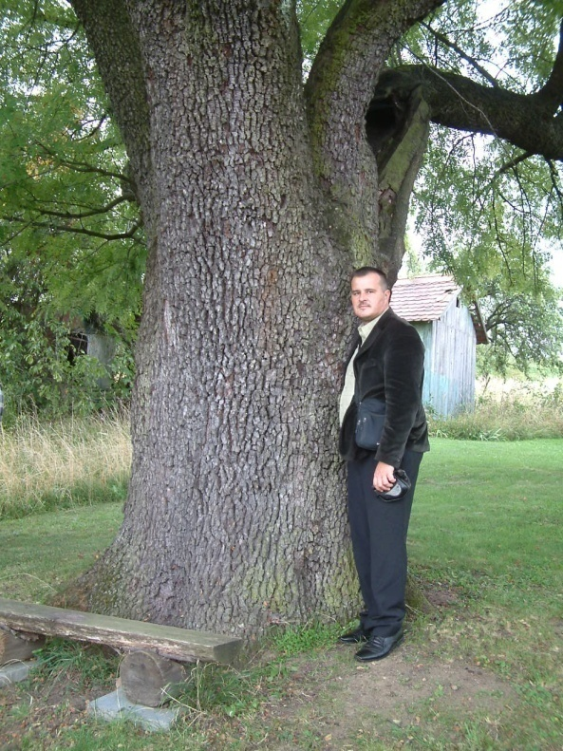
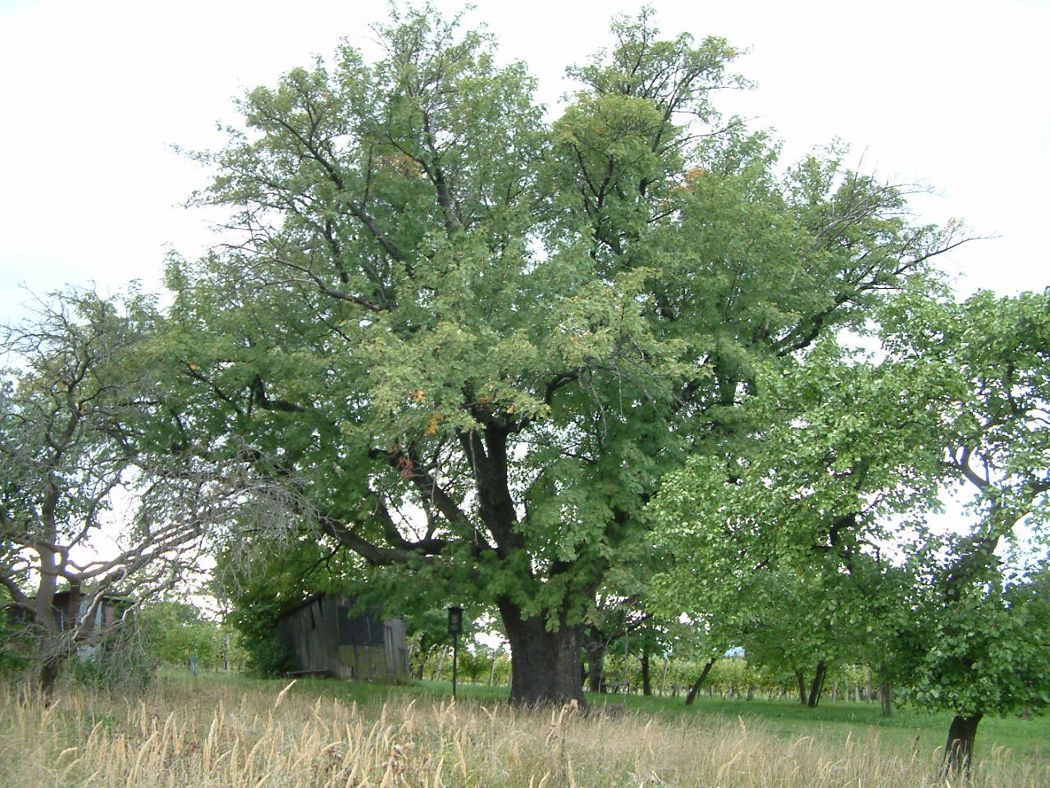
The largest service tree in Croatia grows on Papuk perimeter 357 cm (DBH 114 cm-2022, height 16 m, real age 400, planted in 1622)
The thickest service tree in Europe (Adamcova) in the Czech Republic perimeter 486 cm
(DBH 155 cm-2022, height 14 m, 372 years old, planted in 1650)

Slide 8
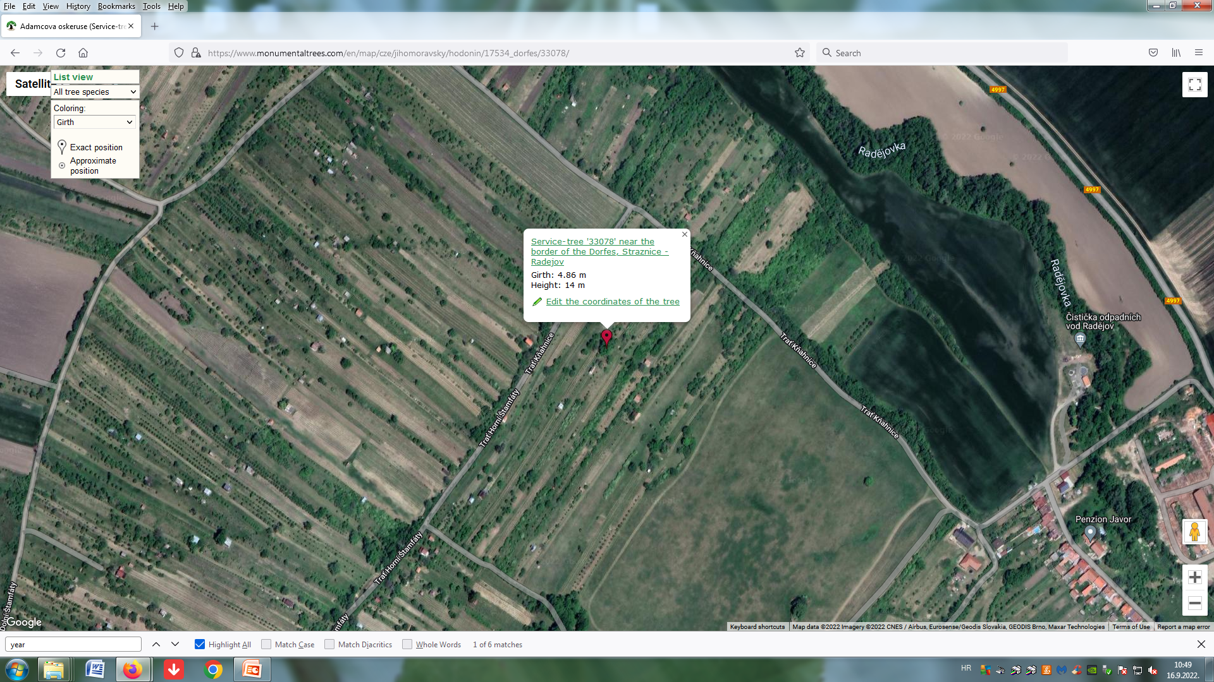
Service-tree 'Adamcova oskeruse' near the border of the Dorfes in Straznice - Radejov, Jihomoravský, Czechia

Slide 9
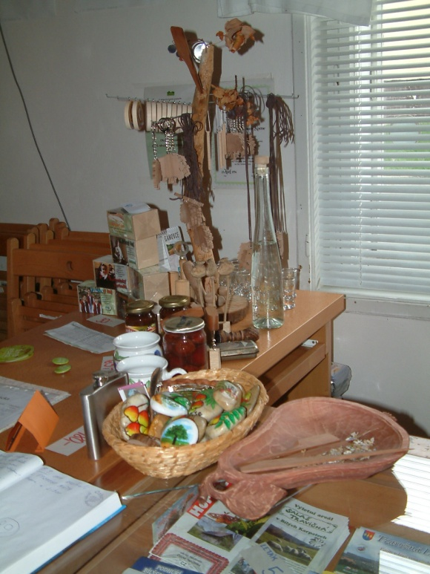
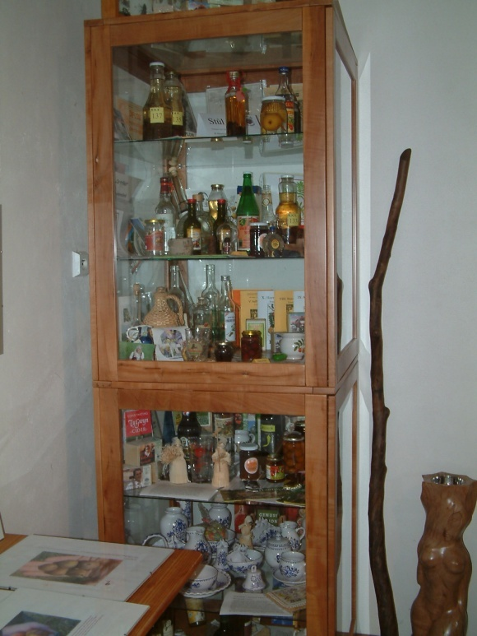
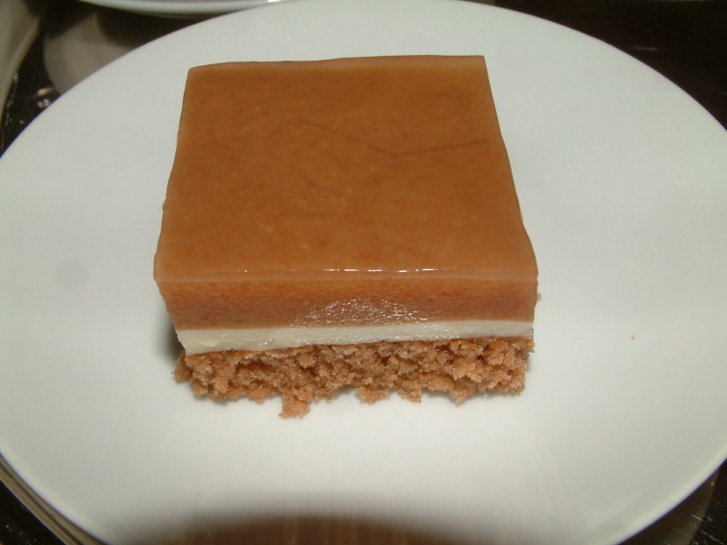
• The use of service tree fruits is manifold (marmalade, tea, liqueurs, brandies, wine, dried as an addition to game food, etc.) and it is said that it cures more than a hundred diseases.
• Products made of service tree are very rare on the Croatian market due to the small number of trees that are scattered and mostly privately owned and difficult collection of fruits.
Service tree cake
• Throughout history, service trees have not been taken care of due to ignorance. The owners of the trees mostly do not recognize the value of the fruits, and the migration of the rural population to larger cities has led to the abandonment of the trees, which today are mostly in poor biological and mechanical condition. No one deals with the revitalization of trees. Young service trees are mostly disappeared in forest care works due to ignorance of the species and favoring of the main species, which is oaks.

Slide 10
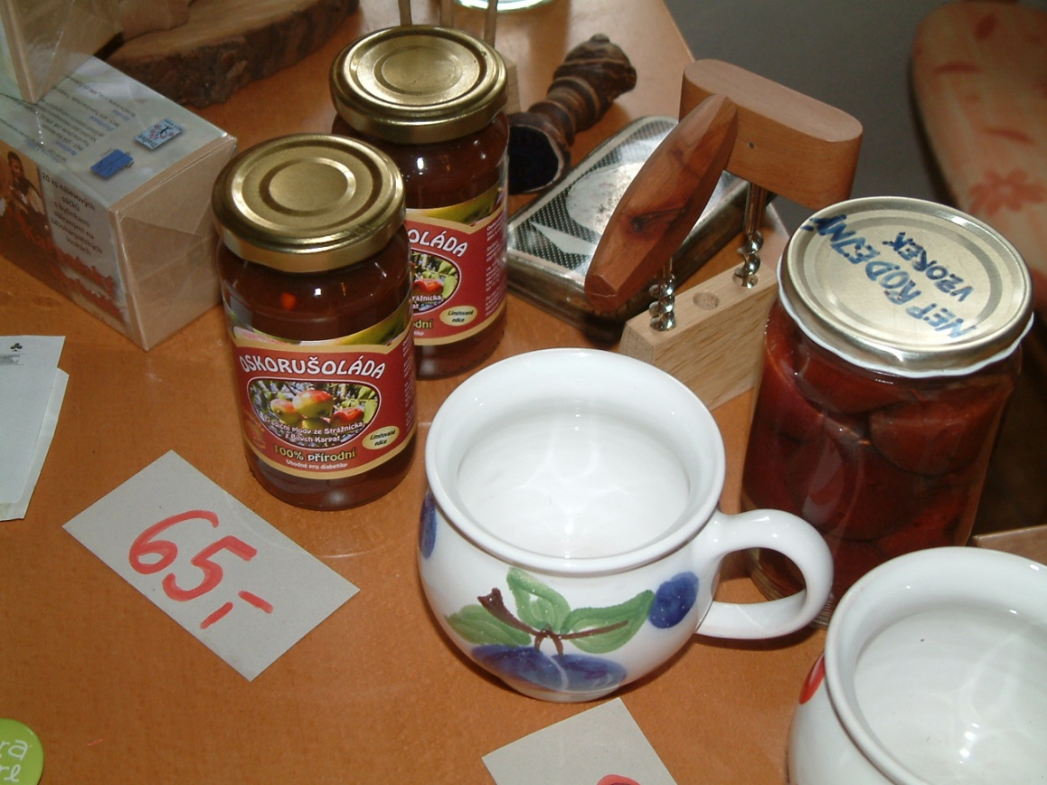
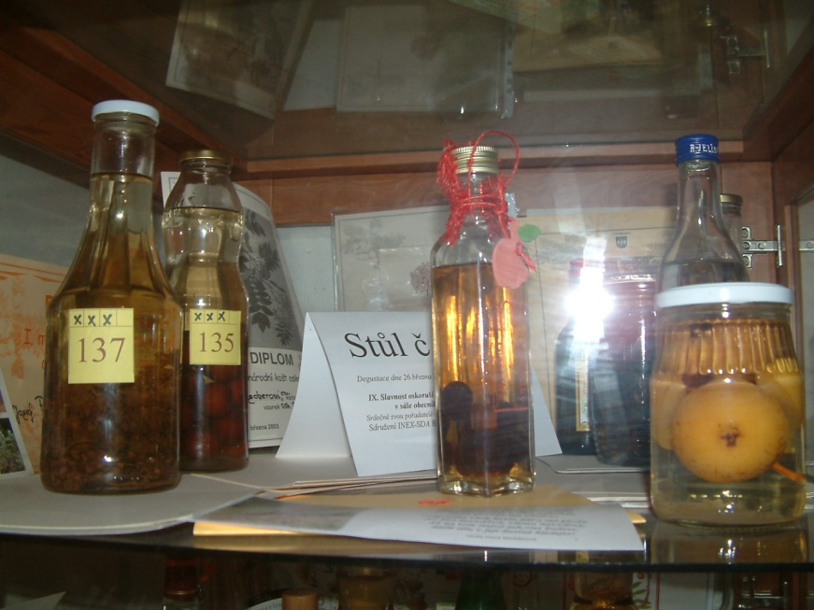
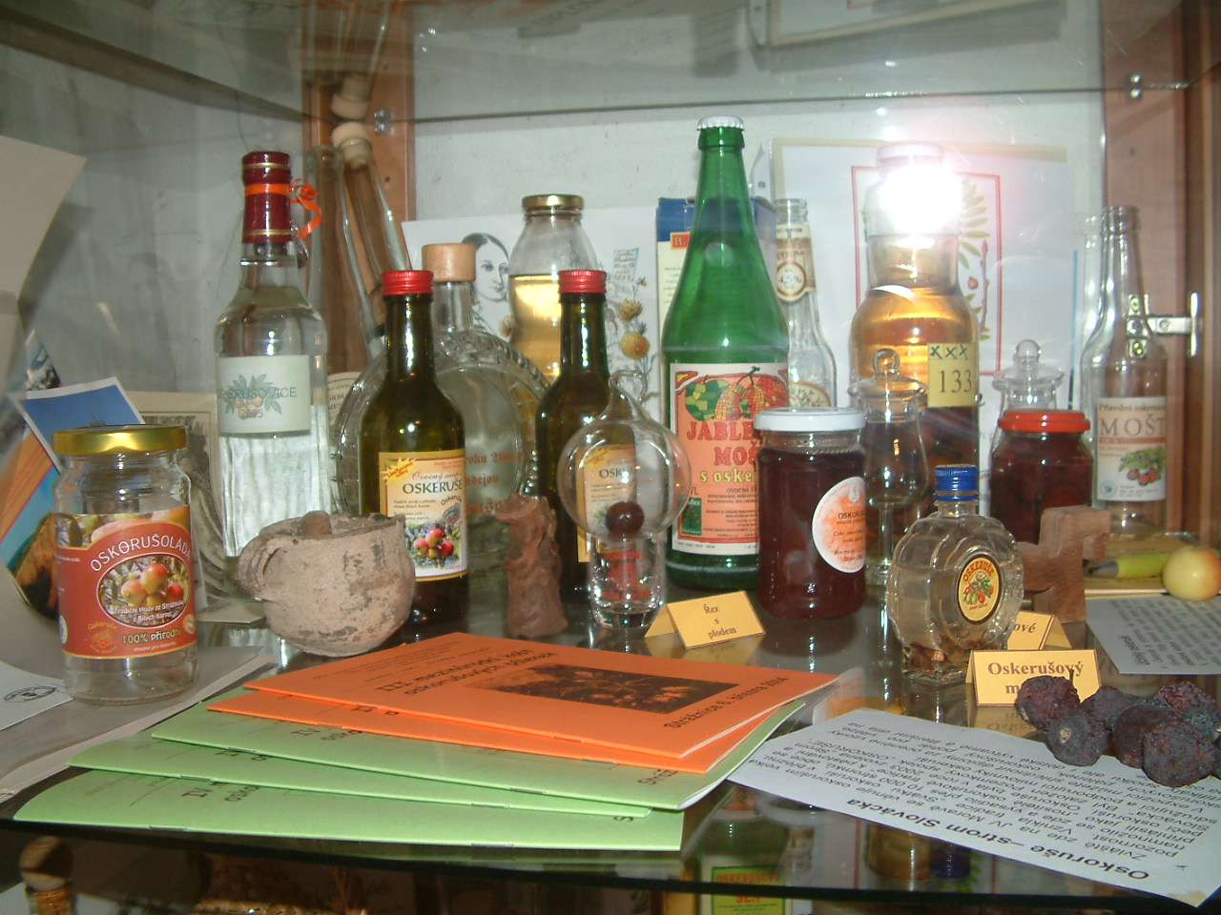
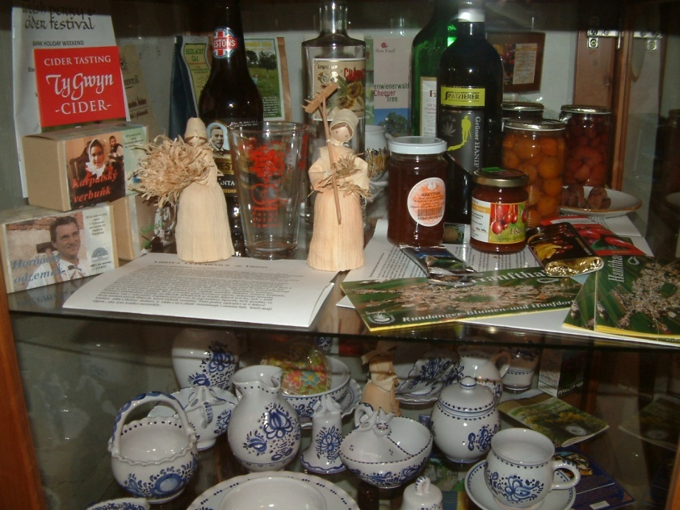
Part of the exhibition of the service tree museum in the town of Tvarožna Lhota in the Czech Republic

Slide 11
• Today in Croatia, service tree has a greater ecological than economic value, even though it is a very expensive wood, which due to its limited quantity on the European market reaches a price of up to 6,000 euros per 1 m^{3.}
• In nature, it is difficult to propagate by seeds in the whole area, vegetative reproduction is possible with shoots from the roots.
• In the nursery, service tree is most often propagations a forest seedling by sowing seeds in the spring, which must undergo 120 days of stratification at 3-5 °C. For the purposes of fruit growing, grafting is used on 2-year-old rootstocks, and the best method is chip budding at the beginning of August, as soon as the buds become ripe. Propagation by green cuttings is possible but does not give satisfactory results for practice like root cuttings. Particularly valuable and sensitive genotypes can be propagated by tissue culture "in vitro".
• In Croatia, service tree is not on the variety list and domestically selected varieties do not exist. Grafted planting material can be found in several nurseries and garden centers, but grafts are often purchased from other EU nurseries. Even though it is not on the variety list, some nurseries in Croatian declare service tree as “Domaća oskoruša”, which is not a good name.

Slide 12
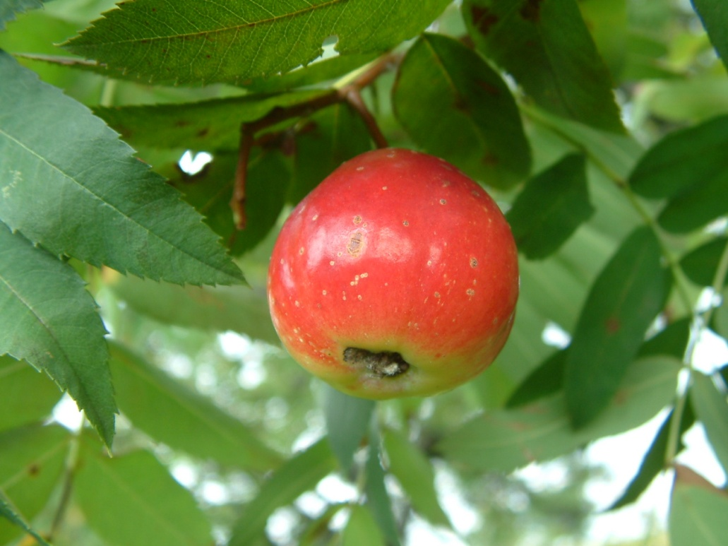
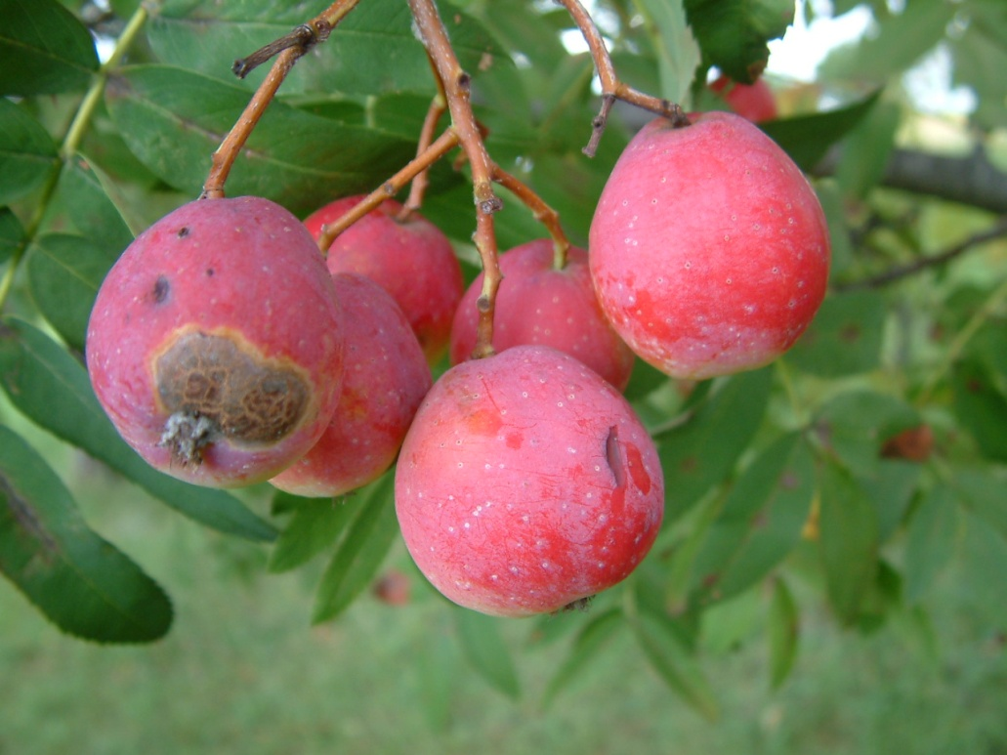
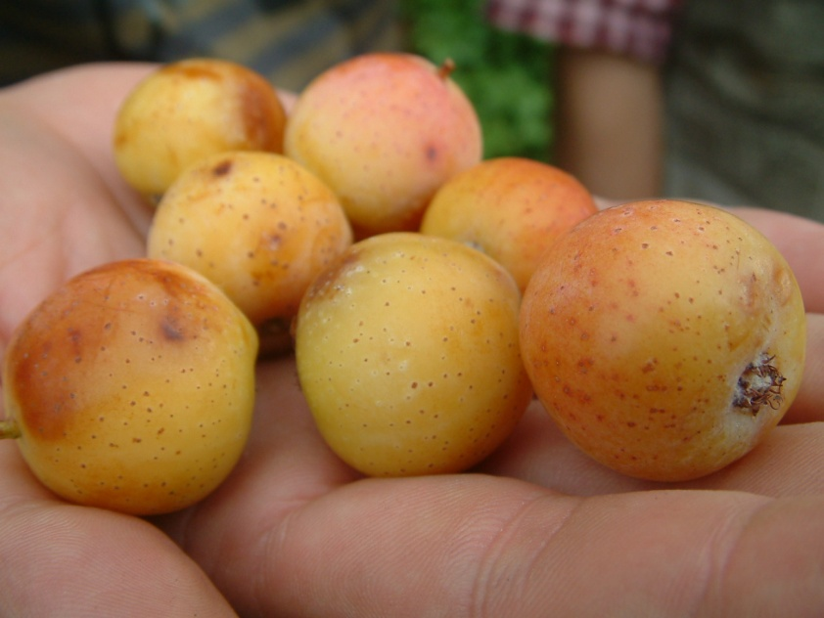
Some of the selected genotypes fruit in the Czech Republic
• Private service tree orchards have only recently been established as permanent plantations with state incentives, but on smaller areas and with a smaller number of trees. Recently, among foresters and fruit growers, there has been a lot of interest in the cultivation of service tree as a forgotten forest fruit tree.

Slide 13
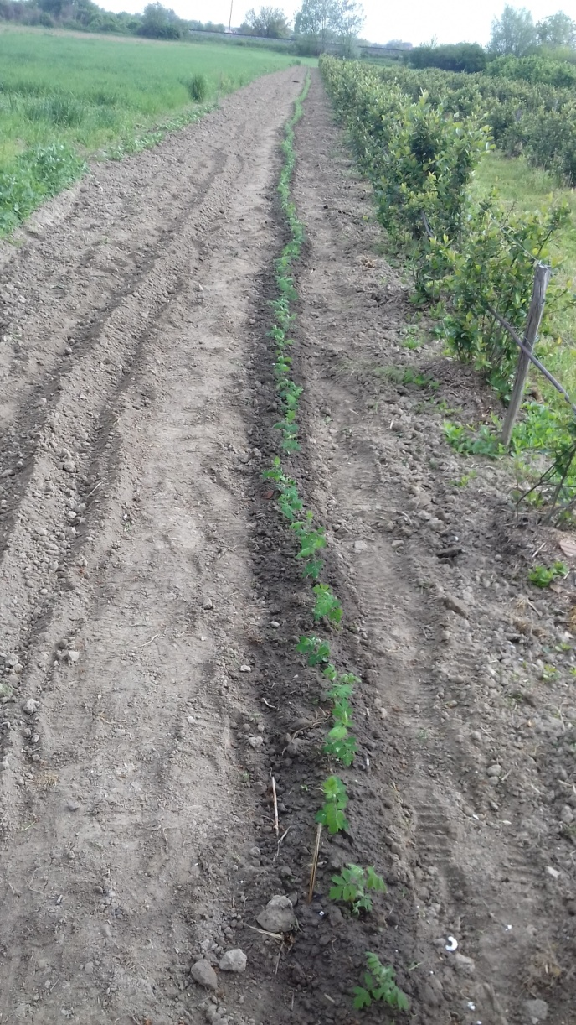
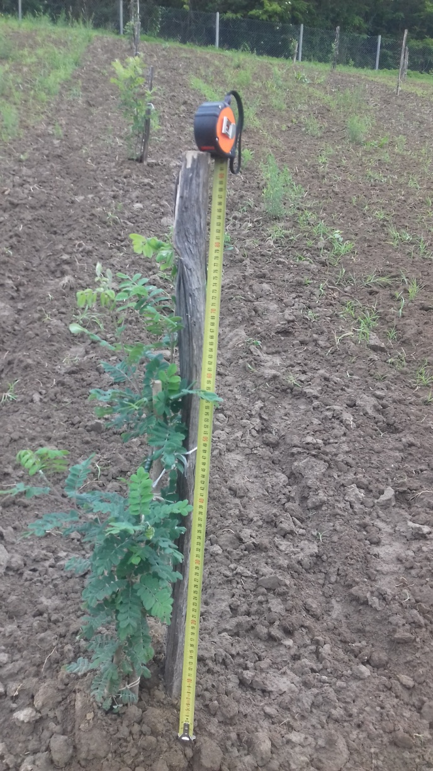
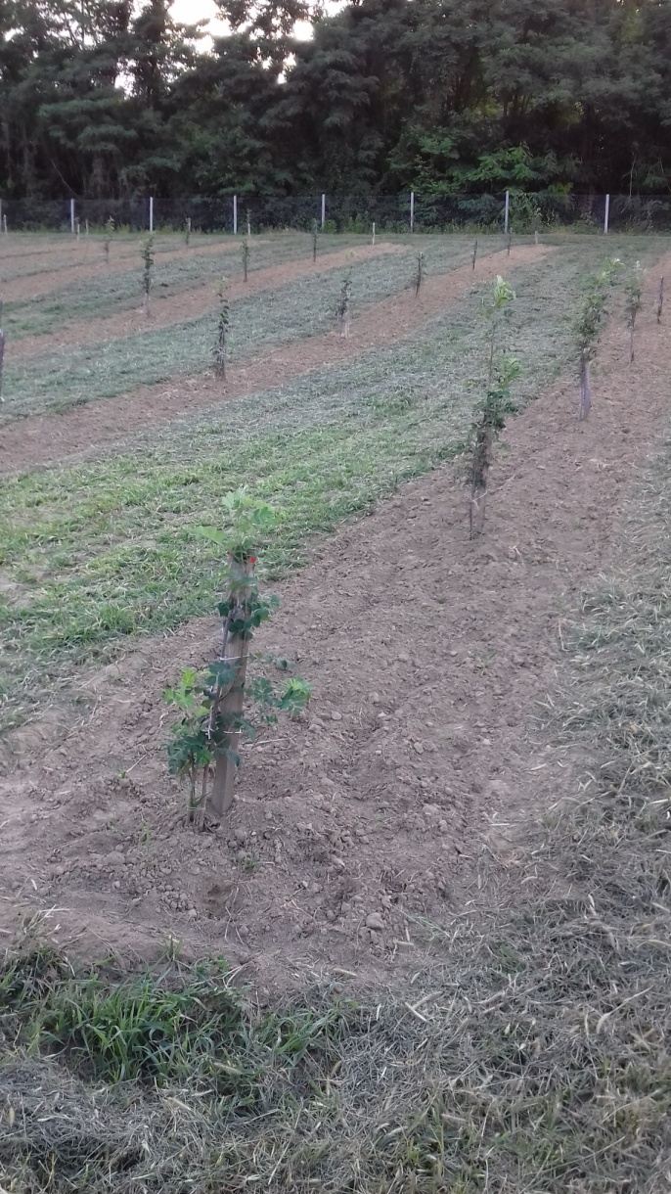
A private service tree plantation established in Virovitica in 2019 with its own propagation of planting material aged 1+0
• So far, no one has investigated the issue of selection of especially valuable genotypes of service tree for forestry or fruit growing.
• The aim of this work is to investigate the selection of the best service trees with regard to seed quality, and one of the most important is seed nursery germination.

Slide 14
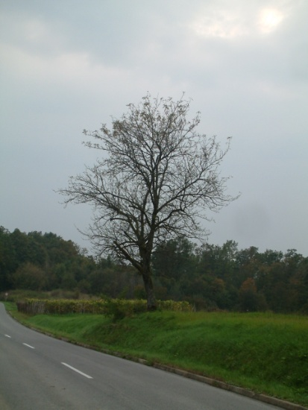
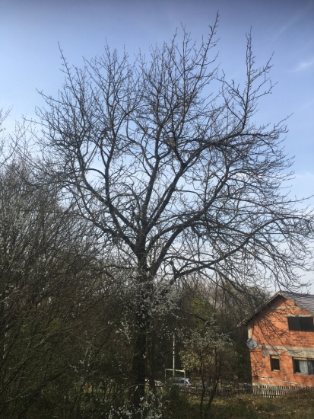
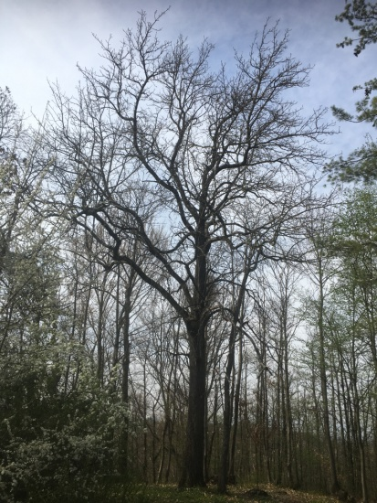
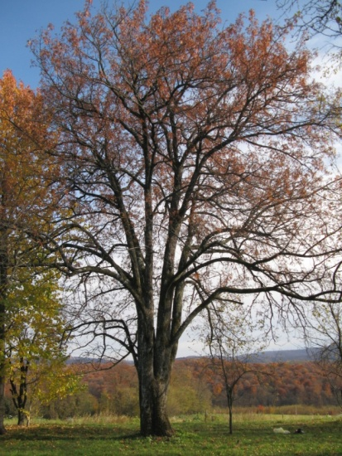
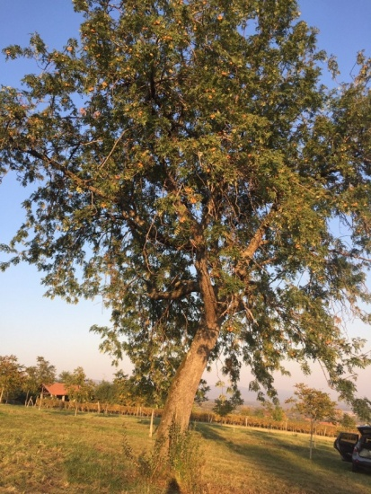
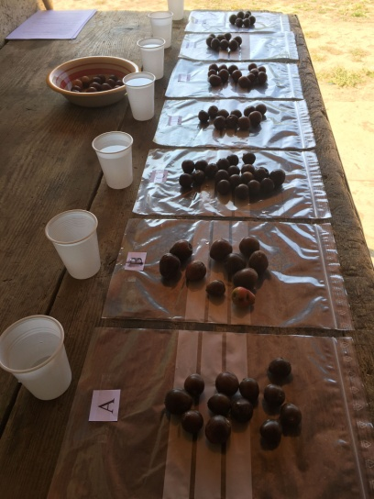
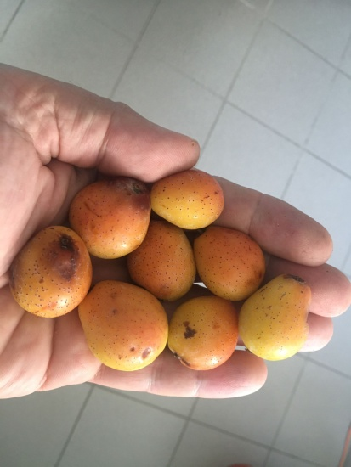
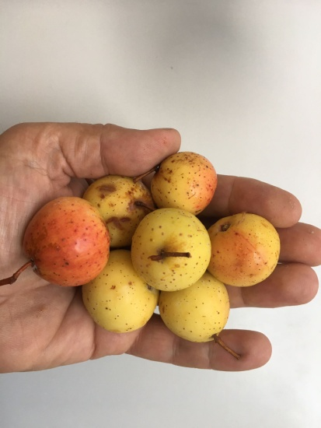
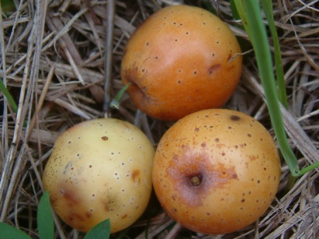
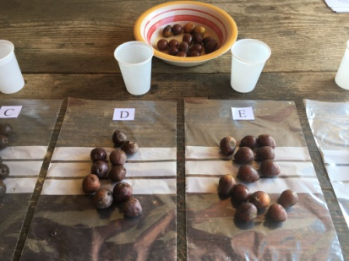
MATERIALS AND METHODS
• Service tree seeds were collected in the autumn of 2021 in the continental part of Croatia from five trees in the wider area of Vukomeričke gorice south of Velika Gorica city (Kravarsko, Cekovići and Šiljakovina) and in the western part of the Požega basin (Daruvar, Velika).
Examples of researched trees
Kravarsko-
solitary tree
Cekovići-
tree on the land border
Šiljakovina-
on the edge of the old forest
Daruvar-in the old orchard
Velika-
on a meadow
Fruit tasting
Fruit tasting

Slide 15
• Laboratory analyzes of seeds and stratification were carried out in the Laboratory of Forest Seed and Nursery Production, and seed sowing in the nursery "Forest Garden and Arboretum" of the Faculty of Forestry and Wood Technology, University of Zagreb.
• The seeds were removed from the fruits immediately after collection and stored at room temperature until the time of scanning (STD4800 SCANNER and WinSEEDLE package 2011), weighing (Radwag; ISO 17025, number 220-C41-17-1 and precision to four decimal places) and stratification ( Kirsch Super-720, Offenburg, Germany).
• Before stratification, the seeds were soaked in distilled water at room temperature for 24 hours.
• Stratification was done according to ISTA recommendations for overcoming seed dormancy in species of the genus Sorbus L. After stratification, all germinated seeds were counted.
• The stratification was carried out on 07.12.2021. year in a medium of fire-dried quartz sand, granulations from 0.1 to 0.4 mm. 37% of distilled water was added to the sand immediately before mixing with the seeds. The ratio of seeds to sand was 1 : 4. During the stratification, a little distilled water was occasionally added to the sand with the seeds in order to maintain favorable humidity and take care of aeration. Stratification lasted 112 days at a constant temperature of 3 °C.

Slide 16
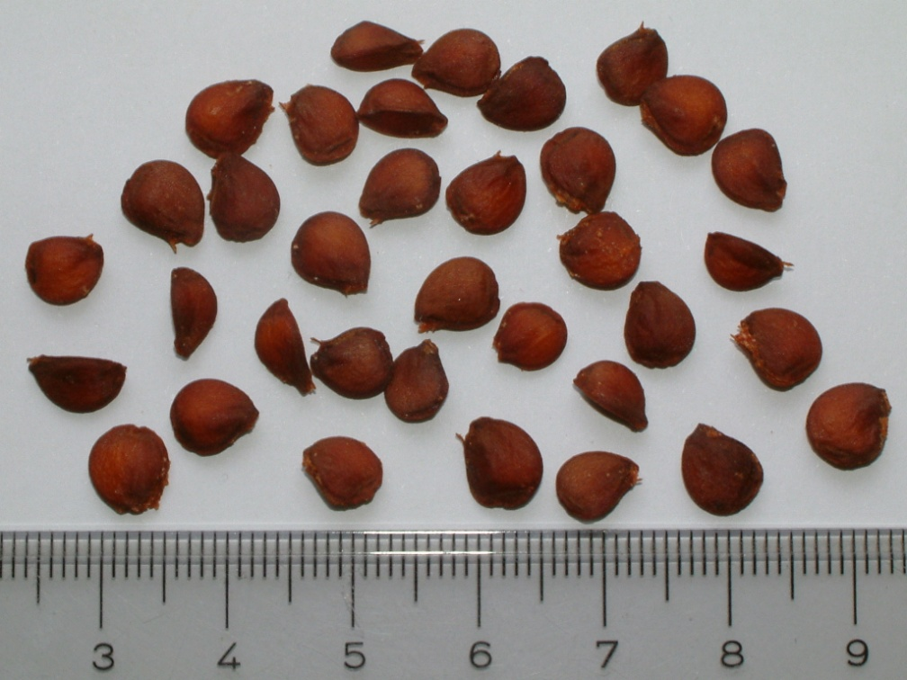
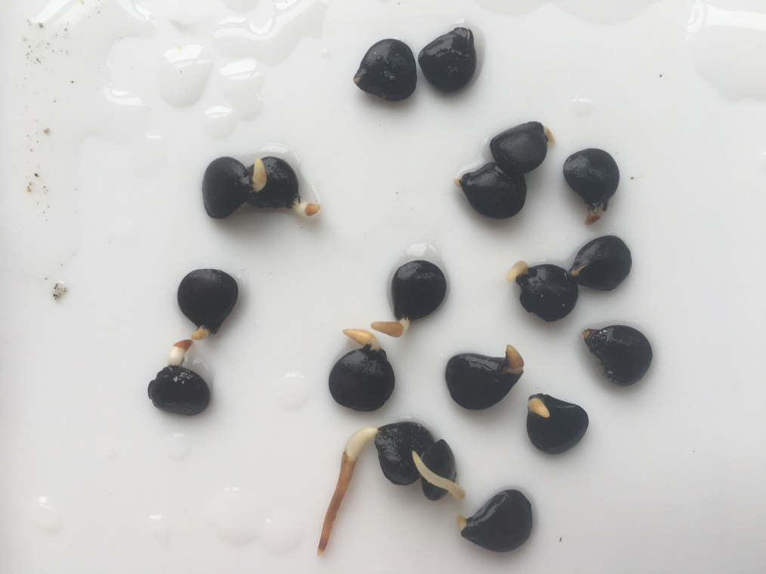
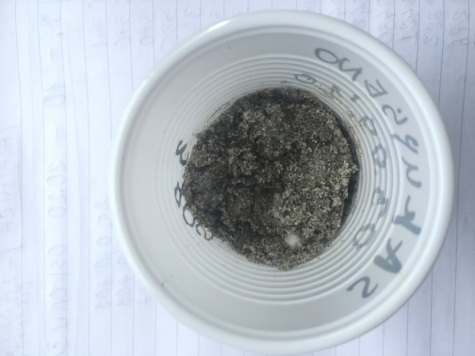
Dry seeds of service tree
112 days stratification at 3 °C
Germinated service tree seeds in the end of stratication
• After stratification, all germinated seeds were counted.

Slide 17
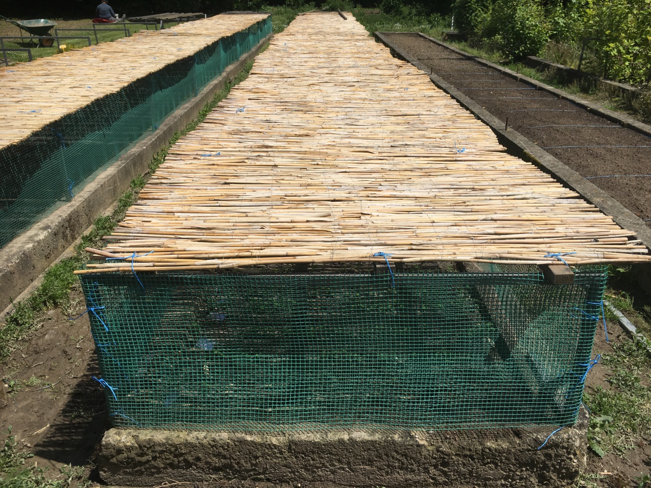
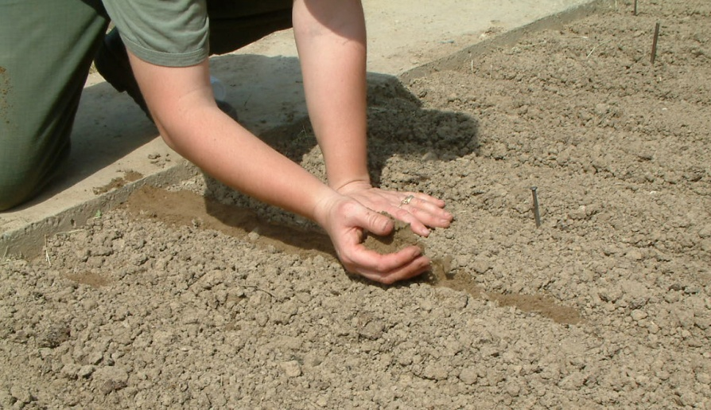
• A total of 1287 seeds from five trees were sown in Dunemann nursery beds on March 29, 2022.

Slide 18
RESULTS
• Seed weight was statistically different between trees, ranging from 0.02552 g (Cekovići) to 0.04385 g (Velika).

Slide 19
• Statistically significant differences were found in the following variables in the 15 morphological characteristics of seeds collected from five service trees: projected area (mm²), straight length (mm), curved length (mm), straight width (mm), curved width (mm), curvature and width/length ratio.
• The service tree from Velika stands out in particular in the highest values of the following seed properties: projected area (mm²), straight length (mm) and curved length (mm).
Kravarsko
Velika

Slide 20
Variables | Locality | N | Mean | Median | Minimum | Maximum | Variance | Std.Dev. | Coef.Var.
Projected area (mm₂) | Kravarsko | 100 | 30,13 | 30,42 | 13,30 | 39,06 | 19,65 | 4,43 | 14,71
Straight length (mm) |  |  | 7,28 | 7,29 | 5,98 | 8,39 | 0,31 | 0,55 | 7,61
Curved length (mm) |  |  | 7,44 | 7,48 | 6,08 | 8,68 | 0,28 | 0,53 | 7,17
Ravna širina (mm) |  |  | 5,79 | 5,84 | 3,03 | 6,86 | 0,33 | 0,57 | 9,89
Zakrivljena širina (mm) |  |  | 5,76 | 5,84 | 2,97 | 6,80 | 0,33 | 0,57 | 9,92
Zakrivljenost |  |  | 0,04 | 0,03 | 0,00 | 0,18 | 0,00 | 0,03 | 75,34
Širina/Duljina |  |  | 0,80 | 0,80 | 0,51 | 0,94 | 0,01 | 0,07 | 9,22
Projected area (mm₂) | Cekovići | 100 | 29,29 | 29,77 | 18,66 | 36,32 | 10,38 | 3,22 | 11,00
Straight length (mm) |  |  | 7,18 | 7,21 | 6,17 | 8,19 | 0,19 | 0,44 | 6,15
Curved length (mm) |  |  | 7,46 | 7,49 | 6,35 | 8,91 | 0,25 | 0,50 | 6,66
Ravna širina (mm) |  |  | 5,62 | 5,67 | 3,96 | 6,51 | 0,20 | 0,45 | 8,01
Zakrivljena širina (mm) |  |  | 5,58 | 5,67 | 3,80 | 6,56 | 0,21 | 0,46 | 8,16
Zakrivljenost |  |  | 0,09 | 0,10 | 0,01 | 0,24 | 0,00 | 0,05 | 51,71
Širina/Duljina |  |  | 0,79 | 0,78 | 0,62 | 0,96 | 0,00 | 0,07 | 8,73
Projected area (mm₂) | Šiljakovina | 100 | 33,04 | 33,01 | 21,33 | 40,59 | 16,57 | 4,07 | 12,32
Straight length (mm) |  |  | 7,41 | 7,40 | 6,41 | 8,40 | 0,21 | 0,46 | 6,24
Curved length (mm) |  |  | 7,63 | 7,61 | 6,54 | 9,17 | 0,26 | 0,51 | 6,73
Ravna širina (mm) |  |  | 6,07 | 6,11 | 3,69 | 7,25 | 0,31 | 0,56 | 9,23
Zakrivljena širina (mm) |  |  | 6,05 | 6,08 | 3,67 | 7,34 | 0,32 | 0,57 | 9,38
Zakrivljenost |  |  | 0,06 | 0,07 | 0,01 | 0,19 | 0,00 | 0,04 | 61,71
Širina/Duljina |  |  | 0,82 | 0,83 | 0,44 | 0,97 | 0,01 | 0,08 | 9,63
Projected area (mm₂) | Daruvar | 100 | 29,04 | 29,27 | 18,97 | 35,61 | 10,74 | 3,28 | 11,28
Straight length (mm) |  |  | 7,11 | 7,12 | 5,54 | 8,55 | 0,35 | 0,59 | 8,34
Curved length (mm) |  |  | 7,30 | 7,34 | 5,78 | 8,72 | 0,39 | 0,63 | 8,58
Ravna širina (mm) |  |  | 5,43 | 5,46 | 4,49 | 6,27 | 0,12 | 0,35 | 6,50
Zakrivljena širina (mm) |  |  | 5,43 | 5,49 | 4,47 | 6,24 | 0,12 | 0,34 | 6,32
Zakrivljenost |  |  | 0,07 | 0,07 | 0,01 | 0,17 | 0,00 | 0,04 | 53,12
Širina/Duljina |  |  | 0,77 | 0,77 | 0,59 | 0,94 | 0,00 | 0,07 | 8,91
Projected area (mm₂) | Velika | 100 | 36,38 | 37,33 | 17,53 | 44,60 | 18,72 | 4,33 | 11,89
Straight length (mm) |  |  | 8,08 | 8,11 | 7,01 | 8,97 | 0,18 | 0,42 | 5,23
Curved length (mm) |  |  | 8,29 | 8,34 | 7,19 | 9,14 | 0,18 | 0,43 | 5,16
Ravna širina (mm) |  |  | 6,28 | 6,37 | 3,52 | 7,08 | 0,37 | 0,60 | 9,64
Zakrivljena širina (mm) |  |  | 6,26 | 6,36 | 3,51 | 7,03 | 0,37 | 0,61 | 9,72
Zakrivljenost |  |  | 0,05 | 0,05 | 0,00 | 0,13 | 0,00 | 0,03 | 58,46
Širina/Duljina |  |  | 0,78 | 0,78 | 0,48 | 0,92 | 0,01 | 0,08 | 10,07

Slide 24
• The percentage of germinated seeds after stratification ranged from 10.75% (Velika) to 56.04% (Kravarsko) or an average of 30.82% for all 5 trees.
• Nursery germination was from 37.00 % (Cekovići) to 66.00 % (Velika) or an average of 52.77 % for all 5 trees.
Tree | Number of seeds sown (pcs) | The number of germinated seeds in the stratified (pcs) | Germinated in stratification (%) | Nursery germination (%) | Difference nursery-stratification (%)
Kravarsko | 182 | 102 | 56,04 | 50,00 | -6,04
Cekovići | 105 | 20 | 19,05 | 37,00 | 17,95
Šiljakovina | 200 | 45 | 22,50 | 49,33 | 26,83
Daruvar | 400 | 183 | 45,75 | 61,50 | 15,75
Velika | 400 | 43 | 10,75 | 66,00 | 55,25
MAX.
MIN.
MIN.
MAX.
MAX.
MINIMUM AND OPTIMAL

Slide 25
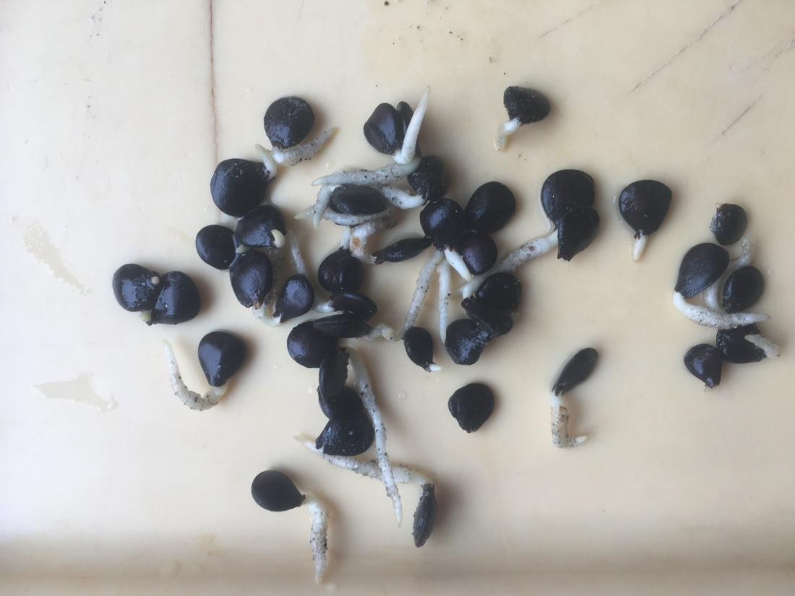
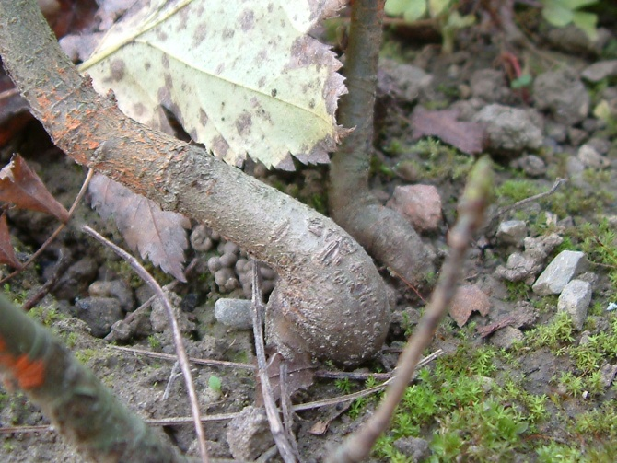
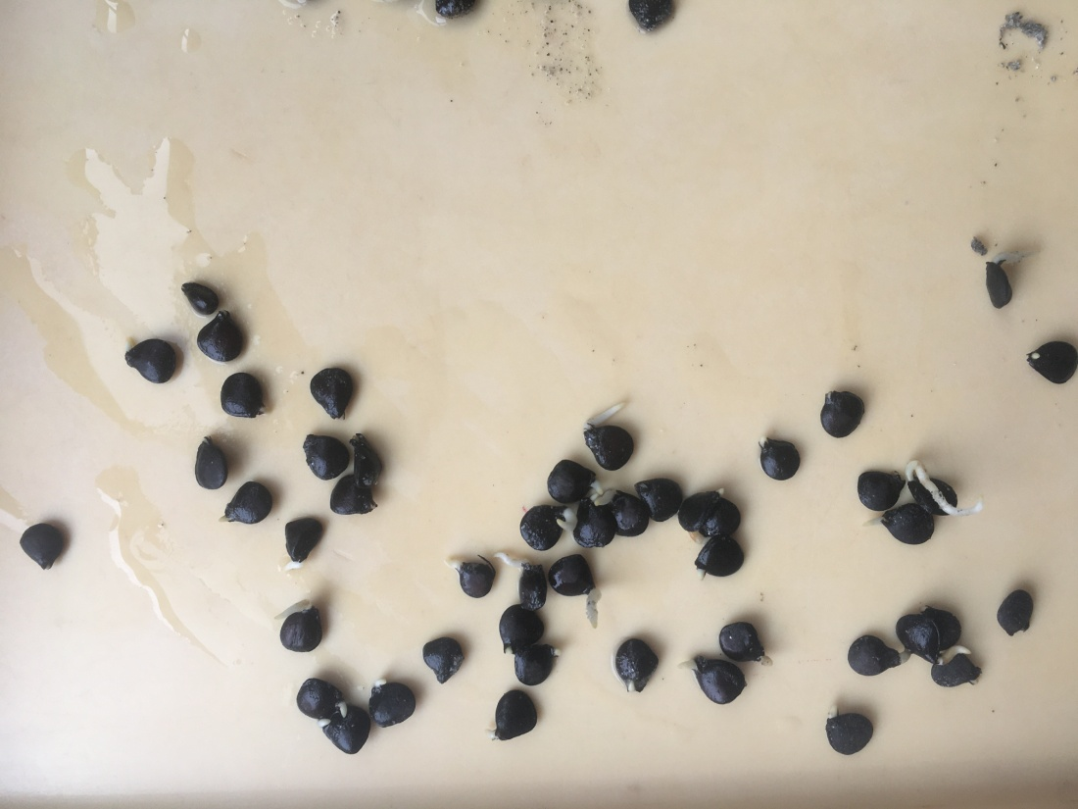
RADICULE LENGTH OVER 5 MM NOT IDEAL FOR SOWING-POSSIBLE ROOT COLLAR DEFORMATIONS
RADICULE LENGTH OF 1-5 MM IDEAL FOR SOWING-NO DEFORMATIONS ON THE ROOT COLLAR

Slide 26
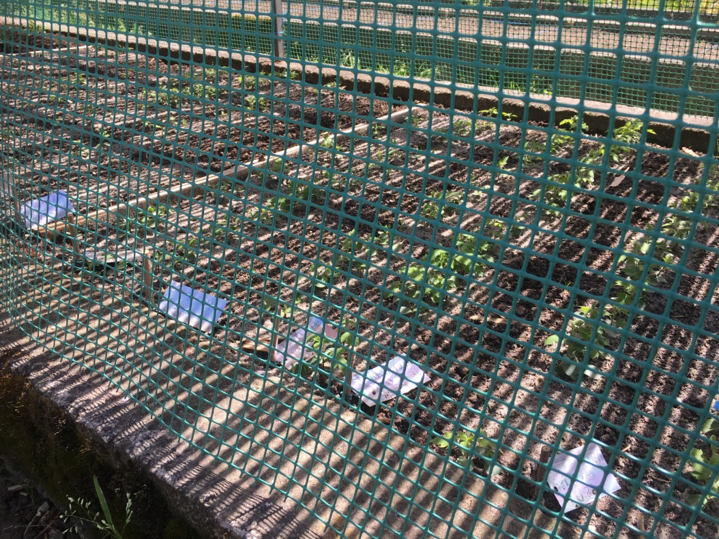
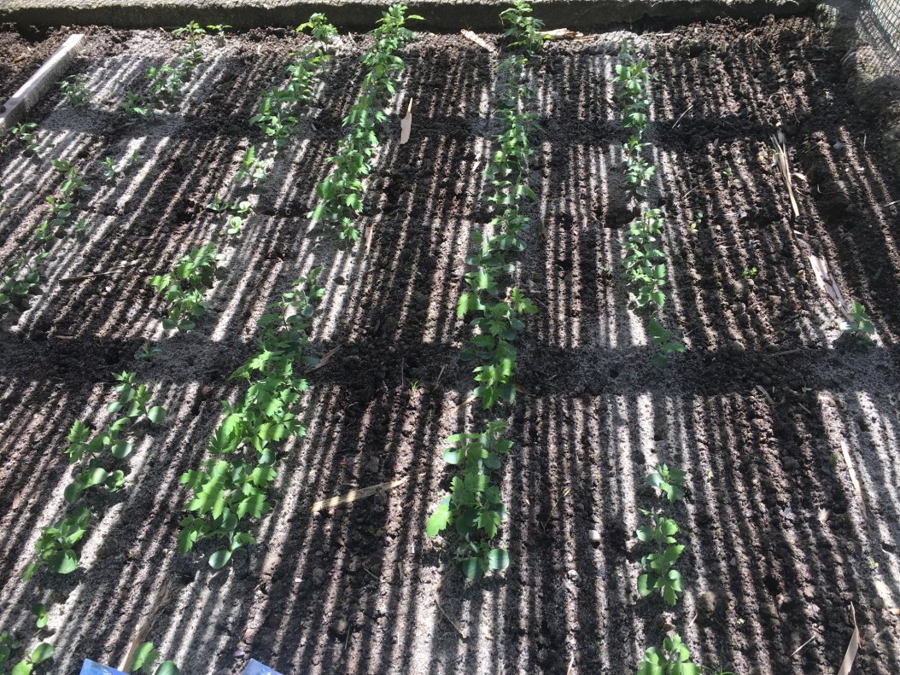
• The seeds started sprouting 14 days after sowing (Šiljakovina and Daruvar) and more massively in all five trees 21 days after sowing. The seeds finished germinating 49 days after sowing (May 10, 2022).
The final germination of the seeds takes place 49 days after sowing. Shade of 50% is ideal for seed germination and growth service tree.
Protection of seeds and seedlings in Dunemann bed from birds

Slide 28
CONCLUSIONS
Seed weight was statistically different between trees, ranging from 0.02552 g (Cekovići) to 0.04385 g (Velika).
The service tree from Velika stands out in particular in the highest values of the following seed properties: projected area (mm²), straight length (mm) and curved length (mm).
The percentage of germinated seeds after stratification ranged from 10.75% (Velika) to 56.04% (Kravarsko) or an average of 30.82% for all 5 trees.
Nursery germination was from 37.00 % (Cekovići) to 66.00 % (Velika) or an average of 52.77 % for all 5 trees.
Selection of the Service tree from Velika is justified, given the quality of the seed. Such genotypes are interesting for forestry (forest seedlings, clonal seed orchards) and fruit growing (raising grafted fruit trees).

Slide 29
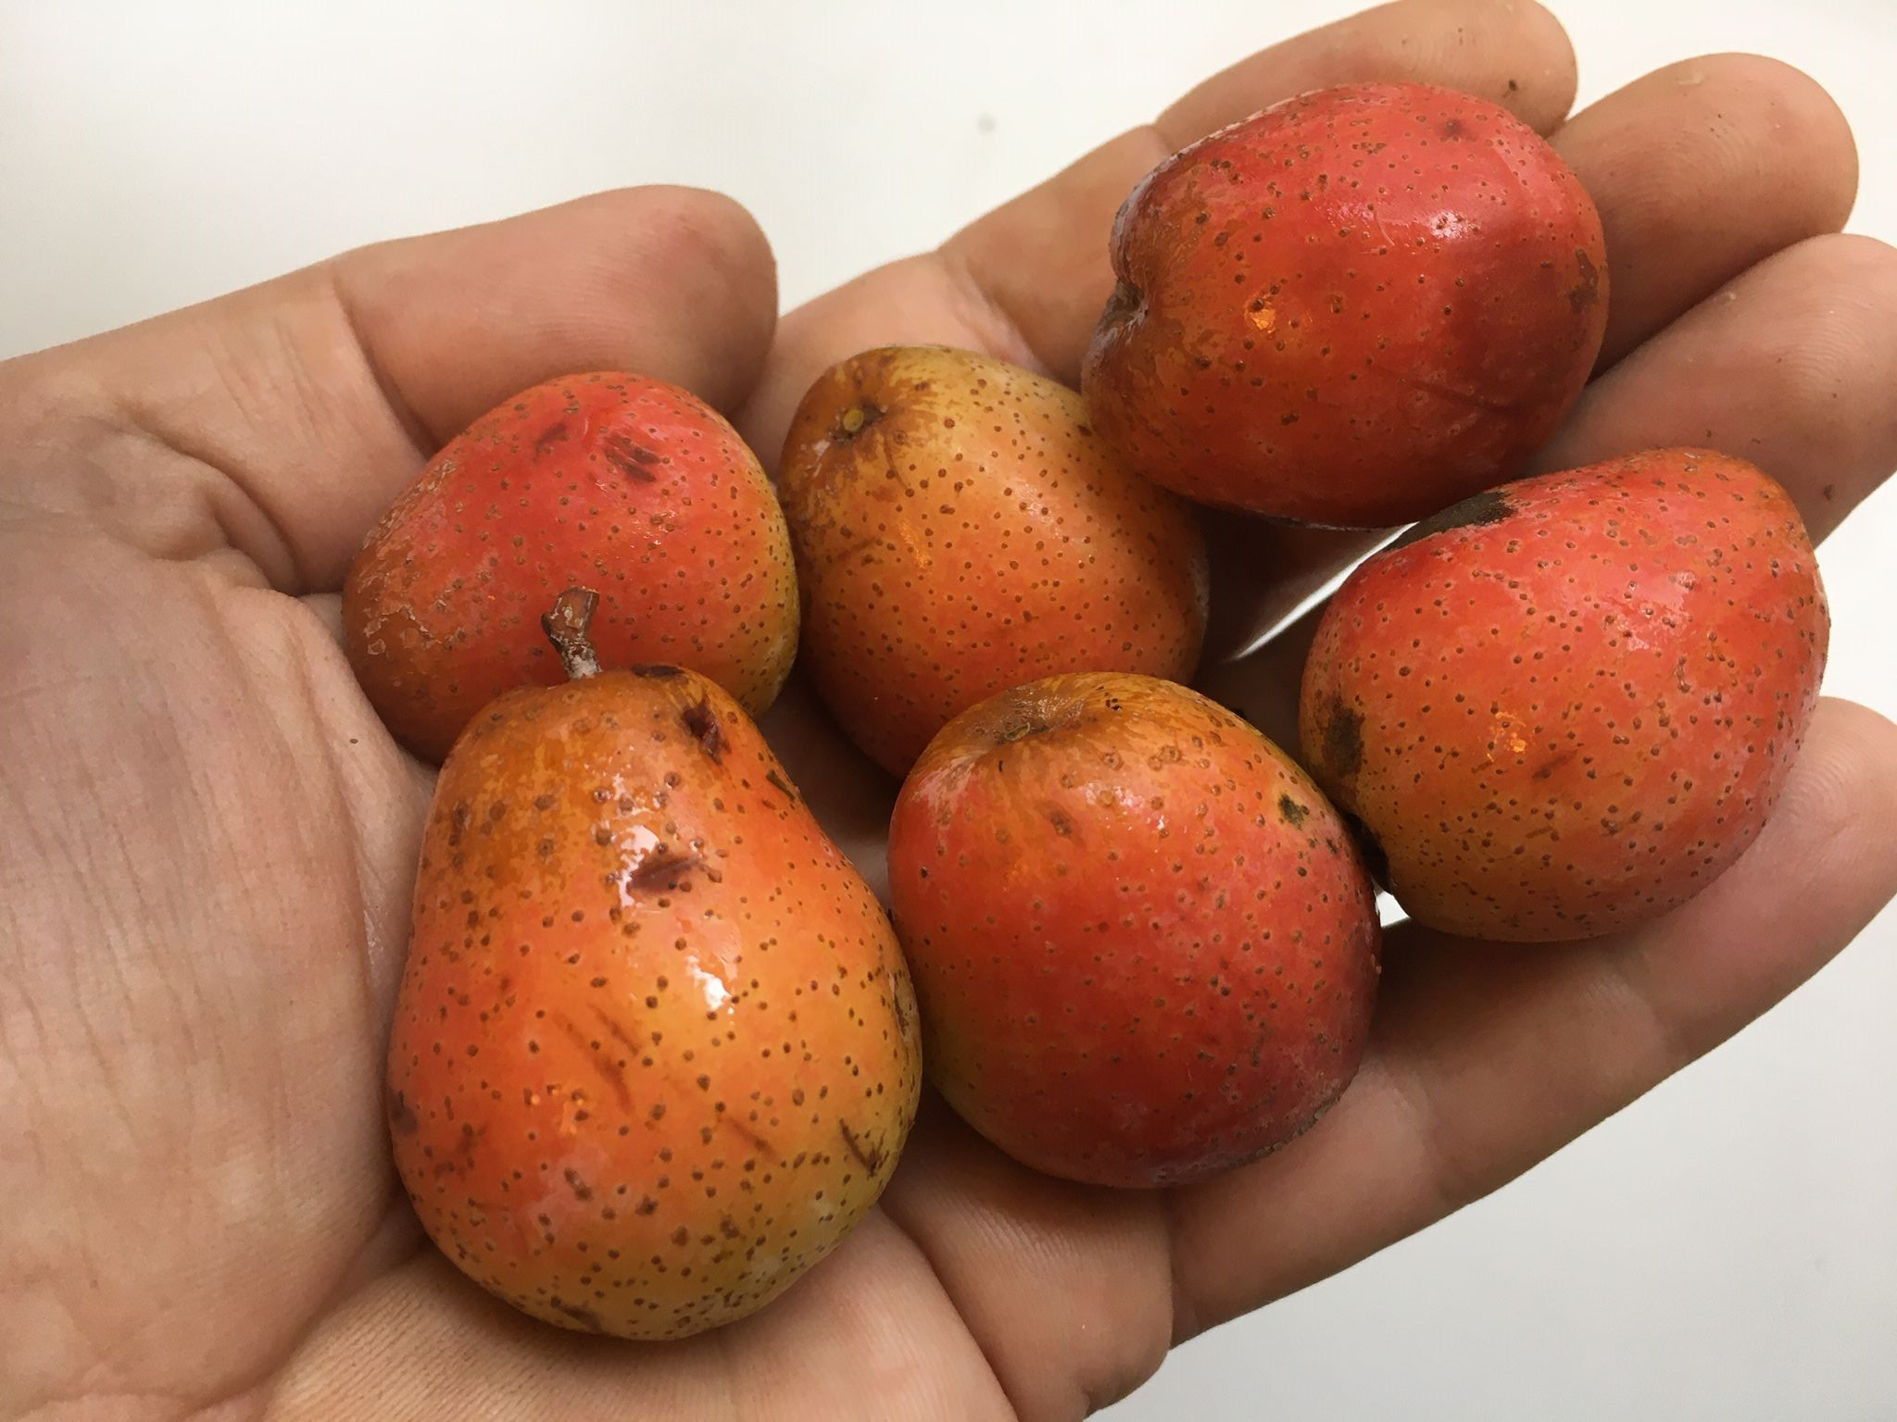
Thank you for your attention !
Contact questions:
drvodelic.damir@gmail.com
ddrvodelic@inet.hr

